Slide 1
Intro to Plate Tectonics
Layers of the Earth

Slide 2
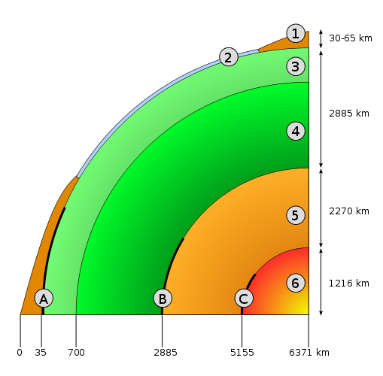
Earth’s Interior
Two ways of looking at Earth’s layers:
chemical properties (what minerals are there)
physical properties (how the minerals behave: solid, liquid, etc.)

Slide 3
Earth’s Interior, CHEMICALLY
Crust (1 and 2)
ex: granite and basalt
Mantle (3 and 4)
more presence of iron and magnesium
Core (5 and 6)
mostly iron, other metals
source of Earth’s magnetic field

Slide 4
Earth’s Interior, PHYSICALLY
Lithosphere (1, 2, and upper 3)
rigid, the so-called “plates”
Asthenosphere (lower 3)
partially molten, can flow over long periods
Liquid Mantle (4)
conducts heat from the core outwards

