Slide 1
Cross Section Help
Considerations when preparing your cross section product

Slide 2
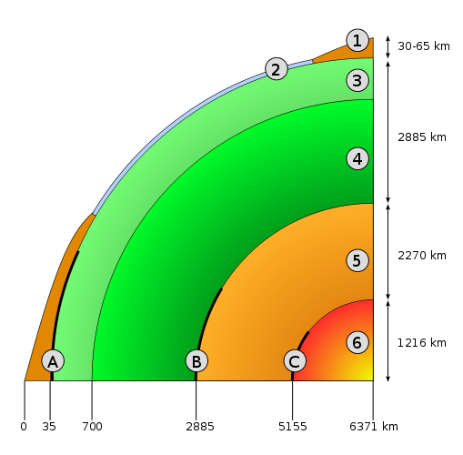
Earth’s Interior
Two ways of looking at Earth’s layers:
chemical properties (what minerals are there)
physical properties (how the minerals behave: solid, liquid, etc.)

Slide 3
Earth’s Interior, Chemically
Crust (1 and 2)
ex: granite and basalt
Mantle (3 and 4)
more presence of iron and magnesium
Core (5 and 6)
mostly iron, other metals

Slide 4
Earth’s Interior, Physically
Lithosphere (1, 2, and upper 3)
rigid, the so-called “plates”
Asthenosphere (lower 3)
partially molten, can flow over long periods

Slide 5
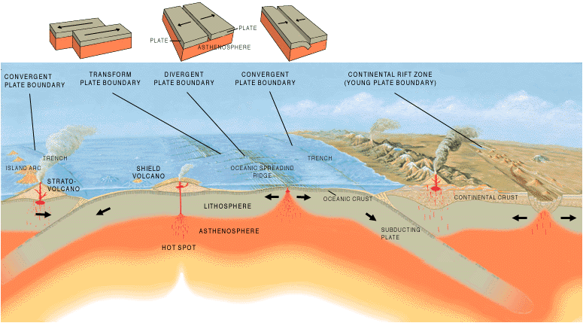
Picking Your Boundary

Slide 6
Picking Your Boundary (ctd.)
Must be convergent or divergent, in your region. Maximum variety encouraged.
For convergent, is it…
Continental-continental
Continental-oceanic
Oceanic-oceanic
For divergent, is it…
Continental-continental
Oceanic-oceanic

Slide 7
More Information = Better
Plate Names and Interaction Type
Directions of movement (NSEW)
Layers of Earth
Lithosphere and asthenosphere
Crust and mantle
Oceanic?
Continental?
APPROX. to scale
Core not necessary
Named Geologic Features
Volcanic arcs or single volcanoes
Magma intrusions below
Trenches
Rift valleys
Ocean ridges
Mountain Ranges
ANY OTHER INTERESTING STUFF

Slide 8
Look again – What to add?

