Slide 1
Water Quality
Adapted From
Ms. Hasan Mr. Aguilar
Uteach Step 2
Lesson 3, 2012

Slide 2
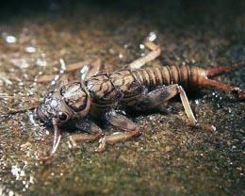
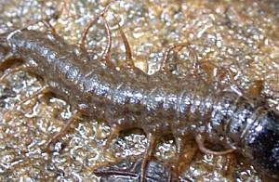
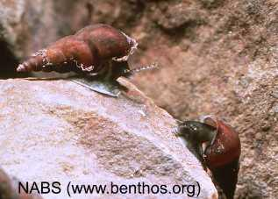
Which one would you rather have in the river that flows through your town?
fig: stone fly larvae
fig: fishfly larvae
fig: lunged smail
Notes:
I just might have this slide be an engagement. Have a question such as which organism would you rather want present in your water? Then do a poll.

Slide 3
Organisms present in water
Many different creatures are present in fresh water bodies
Macroinvertebrates - large organisms that have no backbones; they are easy to collect and are very important in judging water quality of a certain water sample.

Slide 4
What do these tell us?
Presence of different species, indicate different levels of pollution in water bodies
Sensitive to pollution - will not survive pollution
Somewhat sensitive to pollution - may/may not survive pollution
Tolerant to pollution - will survive pollution, but no other organisms will

Slide 5
Instructions
1. Obtain bag containing organism cards.
2. Identify and separate the organisms into the different groups according to the key provided. (You should have 3 different groups sensitive, somewhat sensitive, and tolerant).
3. Count number of each species.
4. Record on data sheet corresponding to sample site. (Site 1 data will go on Site 1 data sheet.
5. Calculate water quality by multiplying number of species by number provided for each category.
6. Add up index values of all three categories to obtain water quality for each site, record on data table.

Slide 6
Sources of Pollution
Point source pollution - when the source of contamination can be easily attributed to an identifiable source e.g. pipe from chicken factory
Non-point source pollution - when the source of contamination cannot be easily attributed to one single source; is more of an accumulation of contamination e.g. runoff from fertilized agricultural land

Slide 7
Chemical Water Quality Tests
Dissolved Oxygen
Nitrates
pH
Phosphates
Temperature (Change in Temperature)
Turbidity

Slide 8
What are the tests?
Use the information to fill out #1-5 on your notes sheet for YOUR test
What is it? (include possible sources)
Why is it important?
How is it measured? (all tests use the tes tablets EXCEPT temperature and turbidity)
What units are used?
How do the different values help determine water quality? (i.e. Is a high value good or a low value good)

Slide 9
Dissolved Oxygen
Oxygen dissolved in the water; produced by aquatic plants, algae, phytoplankton
Aquatic animals/plants need DO to live
Value is compared to temperature to get % saturation. Colder water is more saturated with DO than warmer water
Ppm or % saturation
Levels below 3 ppm are stressful; below 1 or 2 no fish; 5-6ppm required for growth

Slide 10
Nitrates
Nutrient (NO₃) (NO₂) (NH₃) acts as a fertilizer for plants; enters water from: human/animal waste, decomposing organic matter, run-off of fertilizer from laws/crops
It’s a nutrient
Using the tes tabs and looking for a color change
Ppm
Unpolluted waters = below 4ppm
Above 40 ppm = unsafe for drinking water

Slide 11
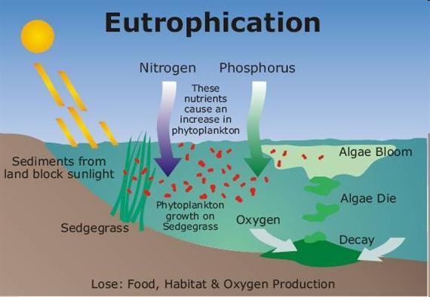
Effects of pollution

Slide 12
pH
Measurement of activity of hydrogen ions
Organisms are sensitive to slight changes in pH
Using the pH scale 0-14. <7 = acidic, >7 = basic
pH values 0-14
Closer to neutral the better

Slide 13
Phosphates
Nutrient (PO₄ )that acts as a fertilizer for aquatic plants; comes from detergents
It’s a nutrient
One tes tab, look for color change
Ppm
Lower values = better

Slide 14
Effects of pollution

Slide 15
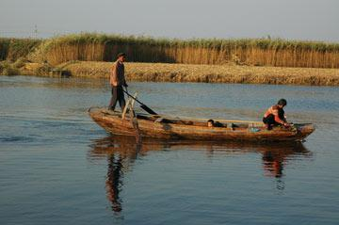
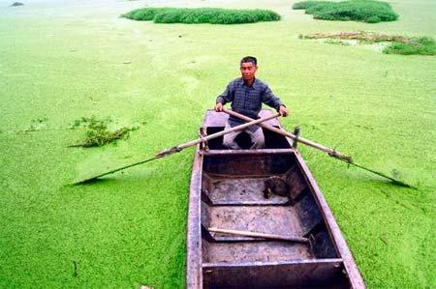
What's going on?

Slide 16
Change in Temperature
average kinetic energy of the molecules in an object or system
Affects amount of dissolved oxygen, rate of photosynthesis, sensitivity of organisms to toxic wastes, parasites, and disease
Using a thermometer. For water quality we look at temperature upstream and downstream then take the difference
ºC
Smallest difference = better

Slide 17
Turbidity
Measurement of relative clarity of water. Turbid water caused by suspended solids, soil erosion, urban run-off, algal blooms
Can indicate sediment disturbances
Secchi disk is used to compare the degree of “fuzziness” to a calibrated standard
Jackson Turbidity Units (JTU)
Lower values = better

Slide 18
Boggy Creek
What are some possible sources of pollution surrounding the creek by Kealing?
How would you describe the water qualitatively?
How has the quality of water changed from last year?

Slide 19
Chemical Water Quality: Analyzing last year’s data
Use the information from sites 1-4 to calculate an average for each test
For TEMPERATURE: Choose one site upstream and one site downstream to calculate a difference (subtract them and use the absolute difference)
Answer Questions on the sheet (short answer)
Fecal coliform is bacteria that grows on fecal matter (E.coli). If you tested for it and the test came back negative, is there coliform in the water or not?

