Slide 1
Solids →
NaHCO₃
KNO₂
NaHSO₃
Gas Collectors →
Add HCL to all solids
CO₂
NO₂
SO₂
½ Distilled water + 10 drops indicator; Then Bubble gases through the wells →

Slide 2
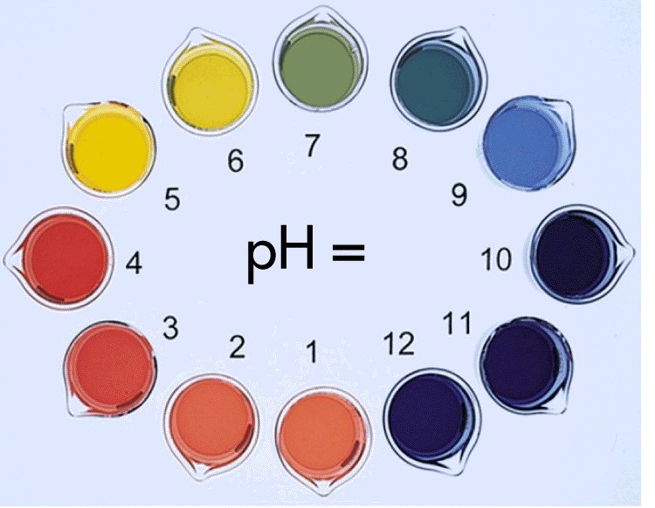

Slide 3
How was the pH scale developed?
How many items in a dozen?
How many items in a score?
How many items in a mole?

Slide 4
A mole is
602 000 000 000 000 000 000 000
items
(or 6.02 x 10²³)

Slide 5
What is a mole?
Why such a large number for the mole?
To group molecules in very large groups in order to be able to get a measurable reading on our balances.
6.02 x 10²³ atomic mass units = 1 gram

Slide 6
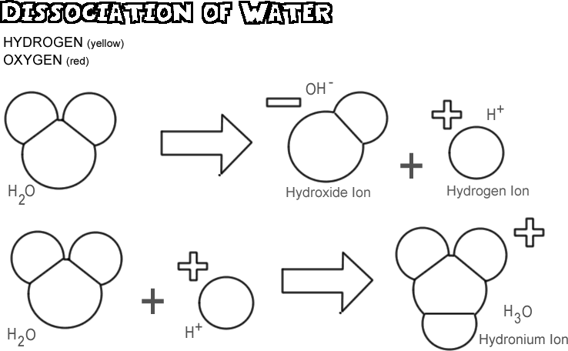
Back to pH
Scientists measured the concentrations of hydrogen ions in pure water, acidic water and alkaline water.
The pure water contained a hydrogen ion concentration of 1 x 10⁻⁷ moles.
The acidic water (hydrochloric acid) contained a hydrogen ion concentration of 1 x 10⁰ moles.
The alkaline water (sodium hydroxide) contained a hydrogen ion concentration of 1 x 10¹⁴ moles.

Slide 7
pH Scale – Thanks Sorenson!
Scientists measured the concentrations of hydrogen ions in pure water, acidic water and alkaline water.
The pure water contained a hydrogen ion concentration of 1 x 10⁻⁷ moles.
The acidic water (hydrochloric acid) contained a hydrogen ion concentration of 1 x 10⁰ moles.
The alkaline water (sodium hydroxide) contained a hydrogen ion concentration of 1 x 10¹⁴ moles.

Slide 8
The hydrogen ion concentration was found to vary over fourteen powers of 10.
To simplify,
-7, 0, 14 exponents were converted to
7, 0, 14, the pH scale we use today!

