Slide 1
Full FX of KTX
Advisory 2013-2014
Notes:
JENNA: 5 MINUTE INTRODUCTION

Slide 2
Schedule
August 26th & 27th: Pass out and collect papers
August 28th-30th: Advisory Introductions:
Name Games, Teacher Neighborhood Artifact
Class Constellation, Circle of String
Grade Assemblies
September 3rd: Student Neighborhood Artifact Show& Tell
September 9th & 10th: Advisory Pennant Contest

Slide 3
Kealing’s cultural identity doesn’t draw from a handful of neighborhoods.
Our identity is built from our students’ diverse backgrounds from all over Austin.
Welcome to Kealing, Texas.
Notes:
JENNA: COMPLETING THE FIVE MINUTE INTRO

Slide 4
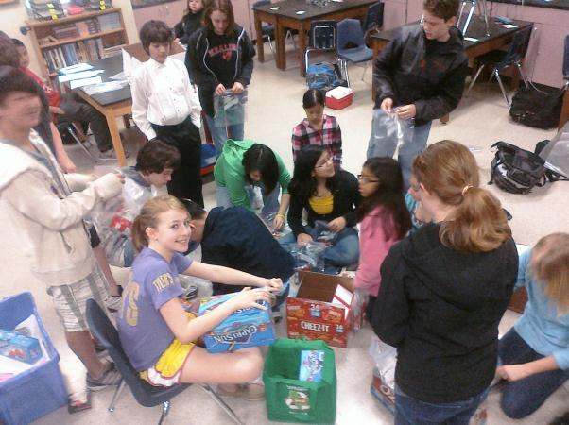
Getting to know your advisory
Dance Move
Red Ball, Red Ball Check
Whoosh, Bang, Pow!
Circle of Commonality
Circle of Trust Chairs

Slide 5
How to Play Ice Breaker Games
Dance Move: Introduce yourself and your dance move. Repeat with the next student, everyone dances and builds on the previous introductions/dance moves.
Red Ball, Red Ball Check: Throw imaginary ‘red ball’ to someone using the recipient's name. Recipient says, ‘red ball check’. That student throws to another student. Continue by creating more imaginary objects.
Whoosh, Bang, Pow!: Whoosh in only 1 direction and to person next to you. Bang reverses the whoosh. Pow across the circle, not someone next to you. You cannot ‘bang’ a ‘pow’. Pick up speed!
Circle of Commonality: Student says someone about his/herself. Students sharing the commonality step in the circle then step out. Repeat until each student has shared.
Circle of Trust Chairs: Set up a circle of chairs like musical chairs (minus 1 from your advisory total). Like Circle of Commonality, ‘out’ person is in the middle of the circle sharing a characteristic about him/herself. If students sitting in the chairs share that characteristic, they rush to another chair, but the chair cannot be next to their own chair.

Slide 6
Advisory Identity Building
Neighborhood Artifact
Class Constellation
Class Pennant

Slide 7
Me on Our Map: Advisory Constellation
Cultural differences should not separate us from each other, but rather cultural diversity brings a collective strength that can benefit all of humanity. -RobERT ALAn
The neighborhood map activity is designed to acknowledge and celebrate the diverse backgrounds and experiences of your ADVISORY.
Through discussion and CREATION OF the human map, you will learn more about your advisory peers and OUR CITY.
Notes:
SOMEONE?

Slide 8
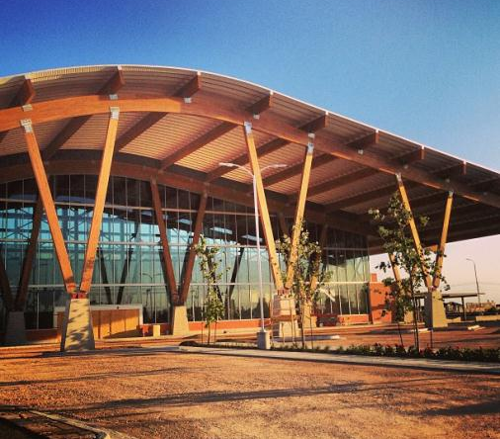
Neighborhood artifact
Please bring an artifact from your neighborhood that represents some you like or respect about where you live.
Help brainstorm ideas: community center, church/temple, restaurant, historical landmark, park, landscape, road..
Teacher will share his/hers the first week of school.
We will announce in the Hornet Herald to remind students to bring artifacts.
Artifacts can go back home or become a part of your pennant.
Students can draw an artifact if need be OR you can do landmark in Austin or place in Austin the student really likes.
After discussing the various parts of Austin, begin to make a human map in your classroom or hallway.
Have students stand in relative proximity to each other.
TIPS: create ‘Lady Bird Lake’ as a starting point.
Notes:
You can also do cultural heritage/landmark/place that they like.

Slide 9
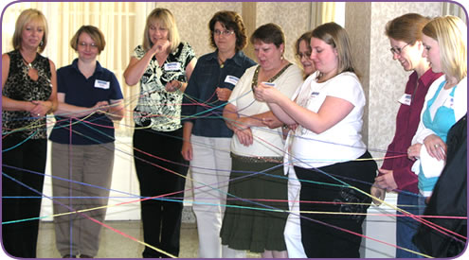
Class Constellation
Students will form human map in classroom according to where they primarily live in Austin.
Take string and say your name and then the person’s name you decide to throw string to and so one and so forth. Each person holds part of the string. REFLECT: What does your image look like? Your image is now your class symbol.
Once complete, try to unwind/untangle the string into a neat circle, BUT everyone must still hold their section of string while doing it. SEE HANDOUT.

Slide 10
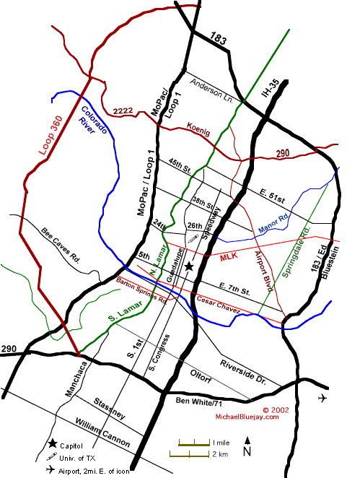
Notes:
ALSO SEE FOR MORE MAPS: http://archive.austinisd.org/inside/2004bond/map/index.phtml

Slide 11
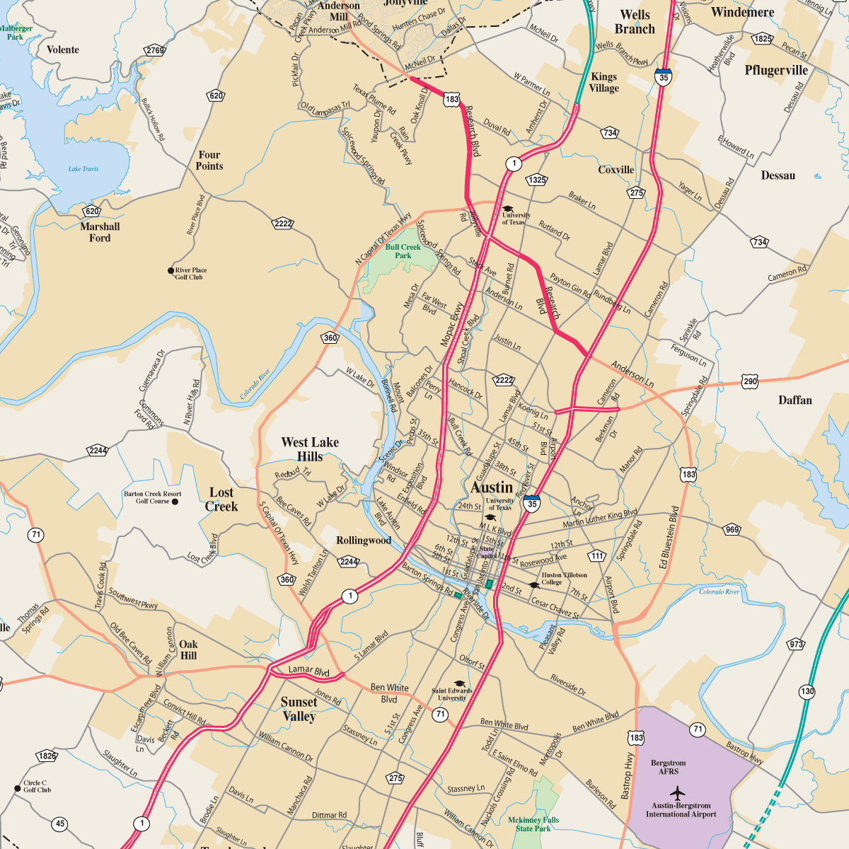

Slide 12
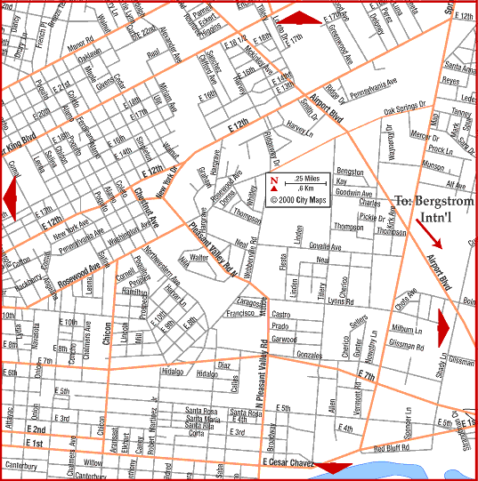
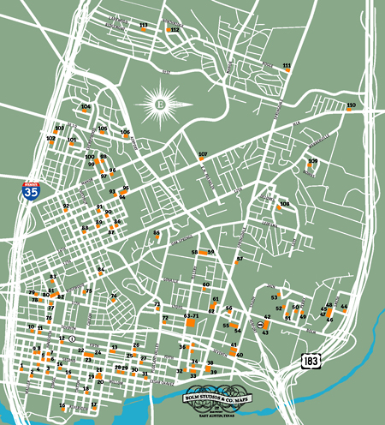
EAST AUSTIN MAPS

Slide 13
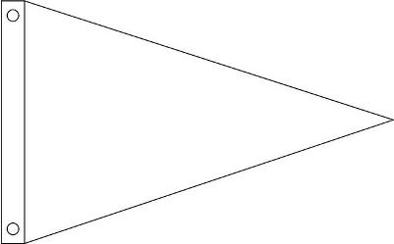
Class Pennant
The lucky Shoafingtons
Your advisory will create a class pennant that will hang outside your classroom for the rest of the year. It should have:
Your advisory name
2 out of the following choices:
Slogan, ritual, image or symbol (can be inspired from constellation)
Have a ‘professional’ look
Notes:
LAURIE?

