Slide 1
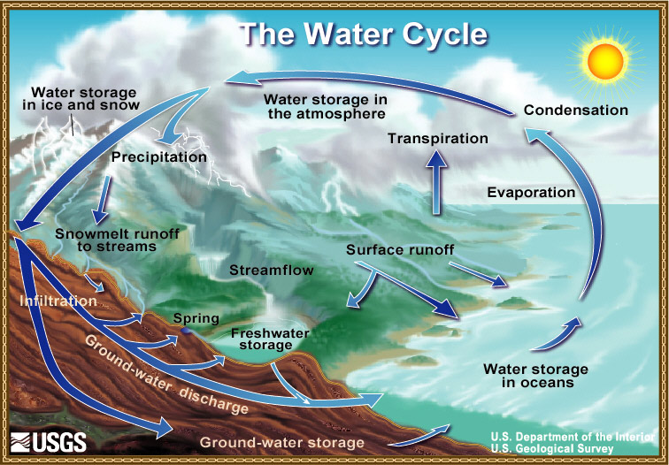
Notes:
The water cycle is not as simple as this as you’ve read about in the peer reviewed article. We spent the beginning of the school year looking at how water in the oceans evaporates and condenses to form clouds along with the energy exchanges involved in those phase changes. In this unit, we will focus on precipitation and where the water is stored and surface runoff. This is the basis for the field trip next week.

Slide 2
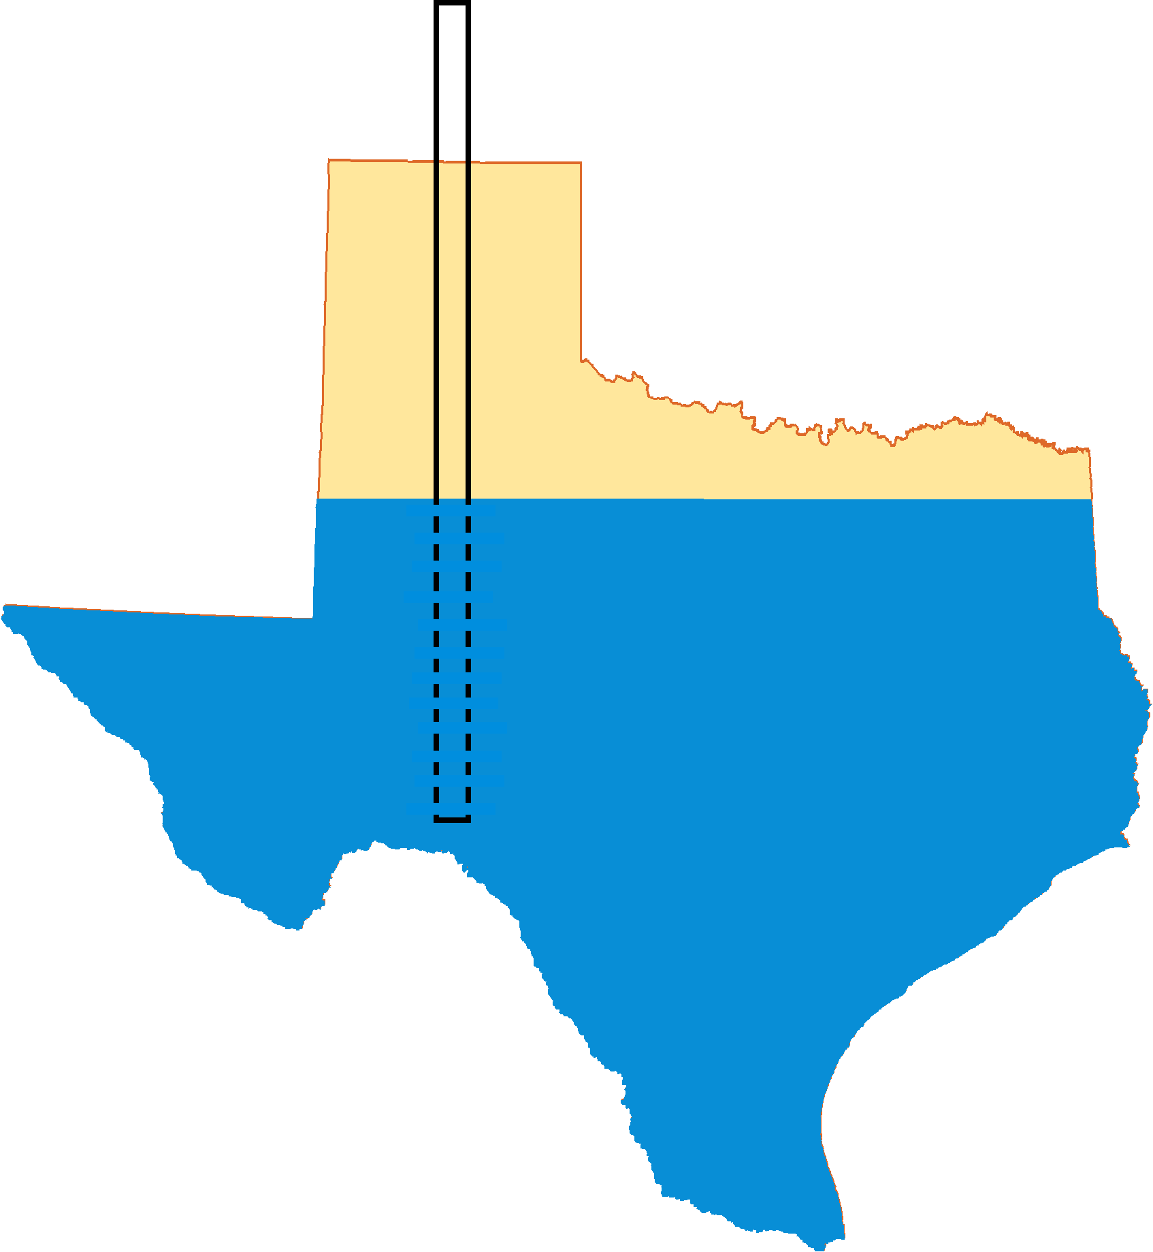
Aquifers 101
Robert E. Mace
Texas Water Development Board
Groundwater 101
November 10, 2010

Slide 3
Outline
Yay for aquifers!
Definitions
Flow through an aquifer
Pumping an aquifer

Slide 4

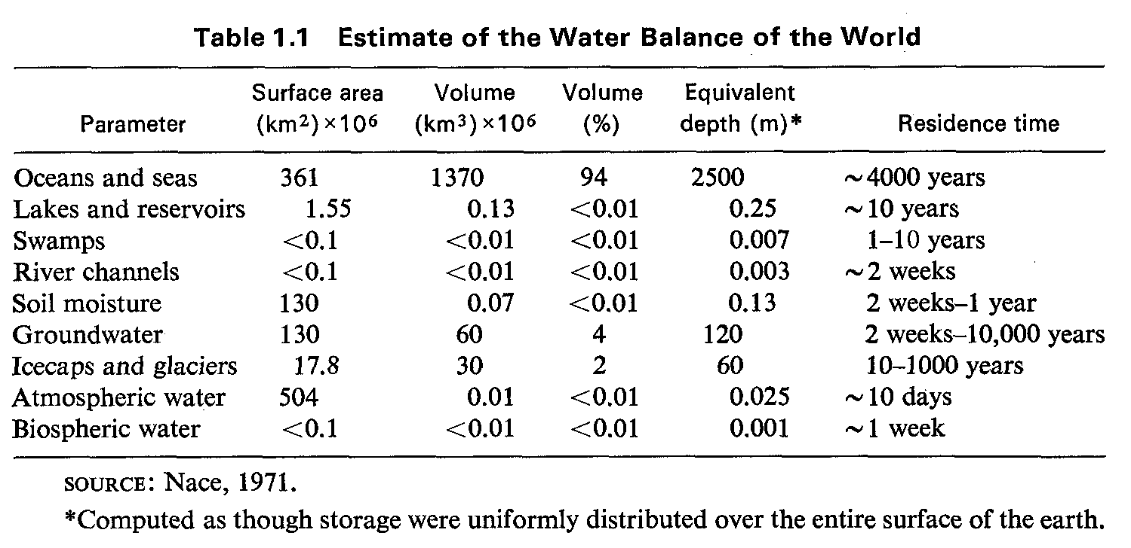
World Water Balance
From Freeze and Cherry (1979)

Slide 5
groundwater and Texas
~60 percent of the 16.6 million acre-feet of water used
~80 percent of groundwater is used for irrigation
groundwater provides 39 percent of water to cities
tastes good when yer thirsty

Slide 6
Examples of Aquifers
The following slides are examples of aquifers
As we discuss them, try to think of how you would define AQUIFER

Slide 7
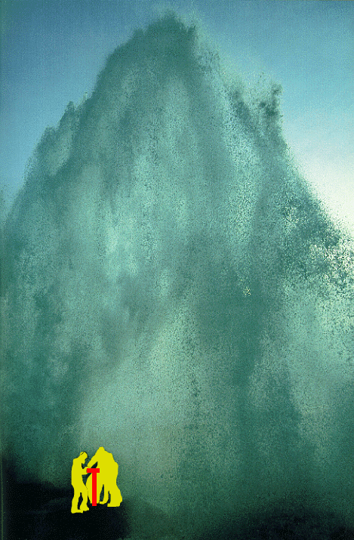
catfish farm well
Edwards aquifer
flowing well at 40,000 gpm
1/4 of San Antonio’s use
9% of Annual Recharge
world’s largest artesian well
National Geographic (1993)
Notes:
Used to run a catfish farm, closed due to fecal coliform, not overuse
Does Darcy’s Law apply? How high can permeability be?
In this aquifer 15% of well tests have no measurable drawdown (called zero drawdown wells)
Supplies San Antonio
Riverwalk
Schlitterbahn

Slide 8
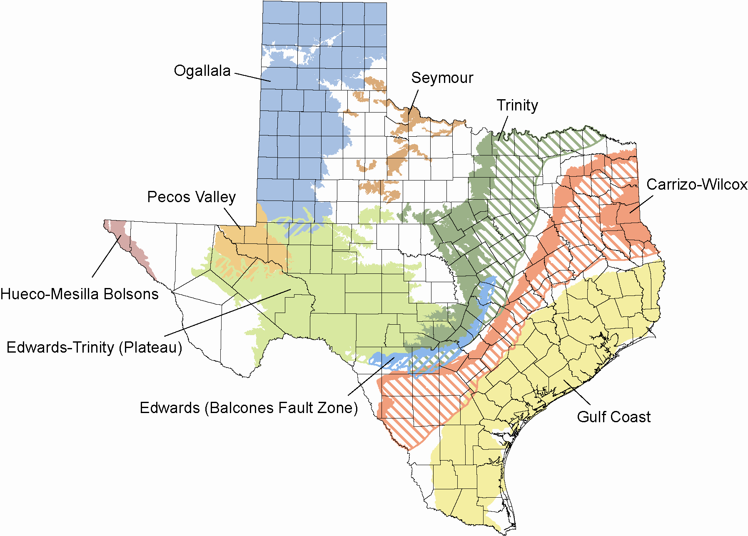
Major aquifers

Slide 9
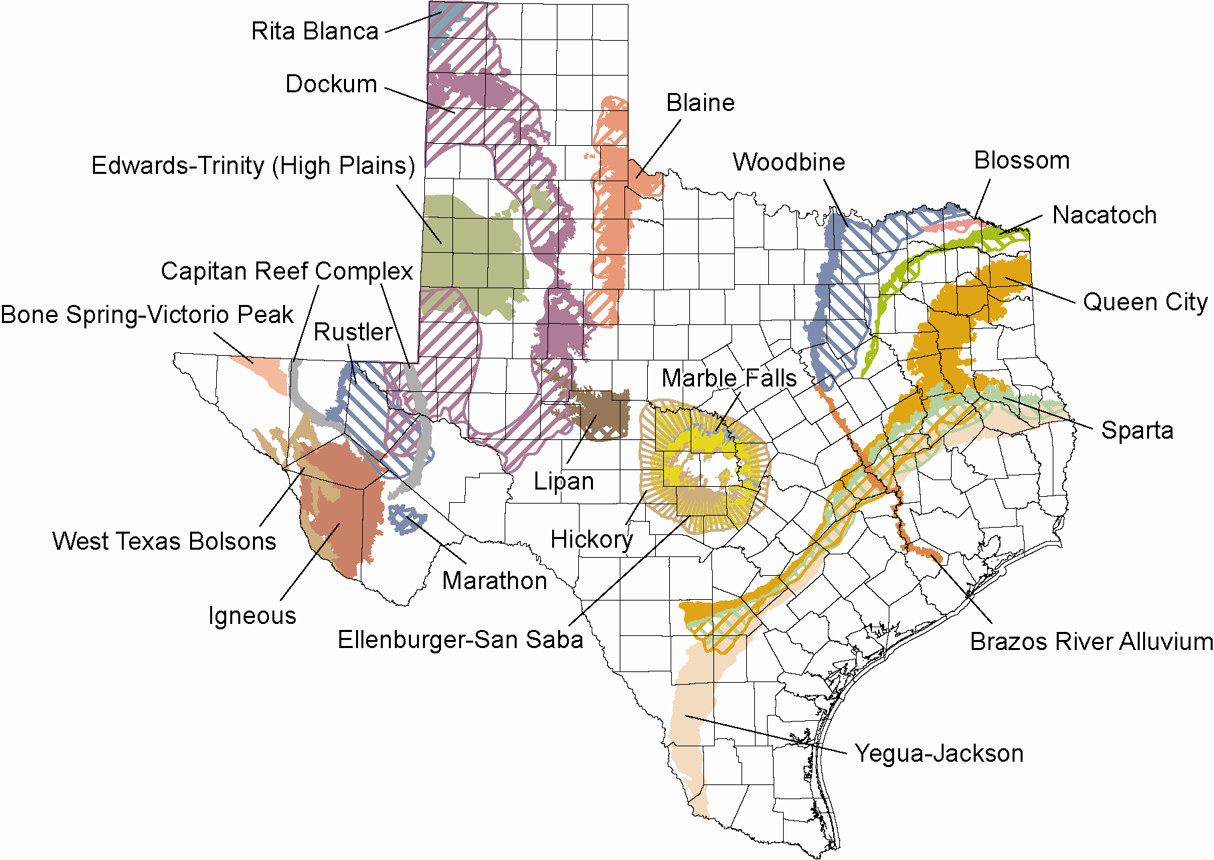
Minor aquifers

Slide 10
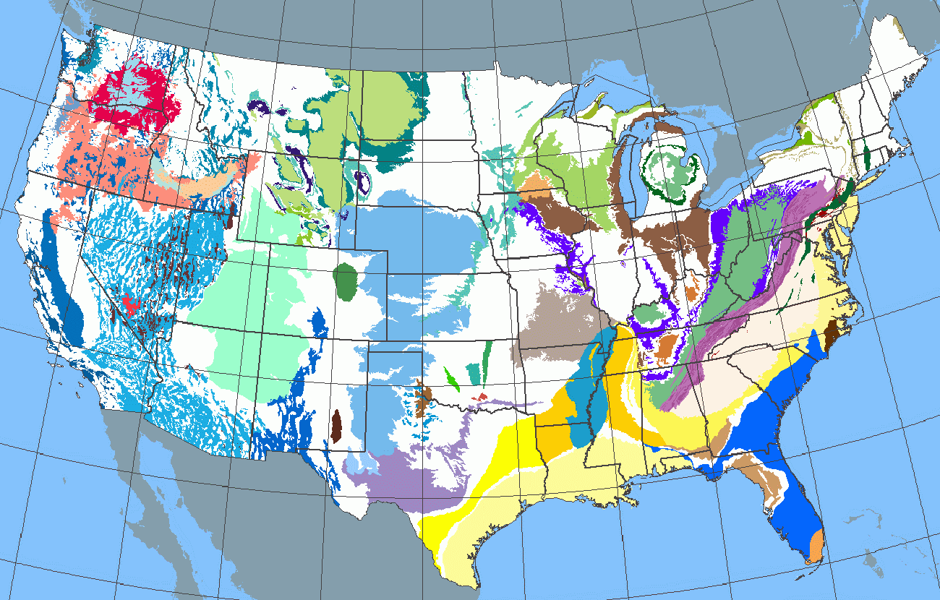

Slide 11
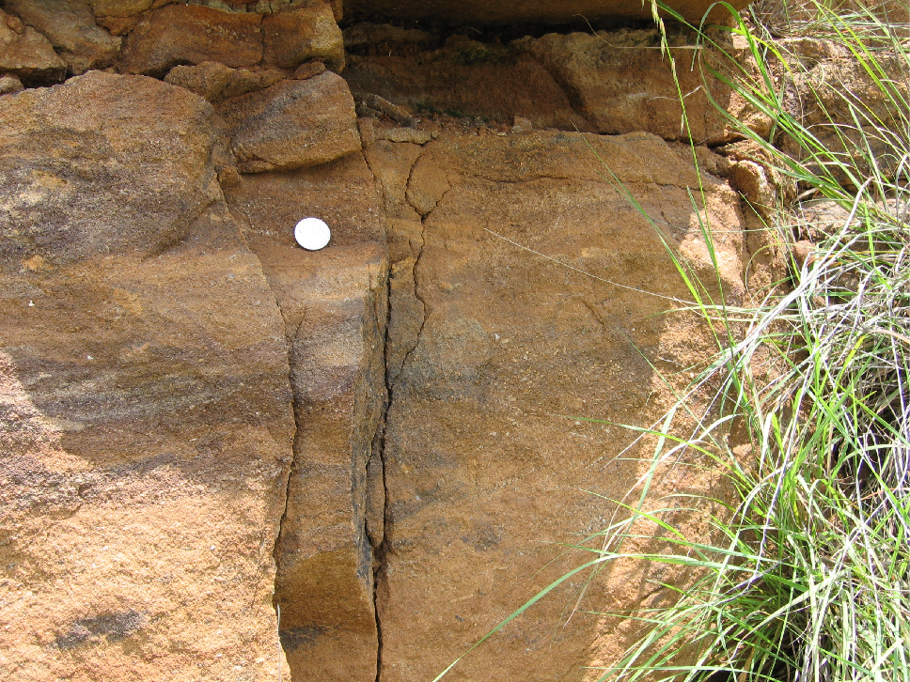
Hickory Aquifer, sandstone
Notes:
Hickory Aquifer, Llano uplift area, near Honey Creek (HW 71)

Slide 12
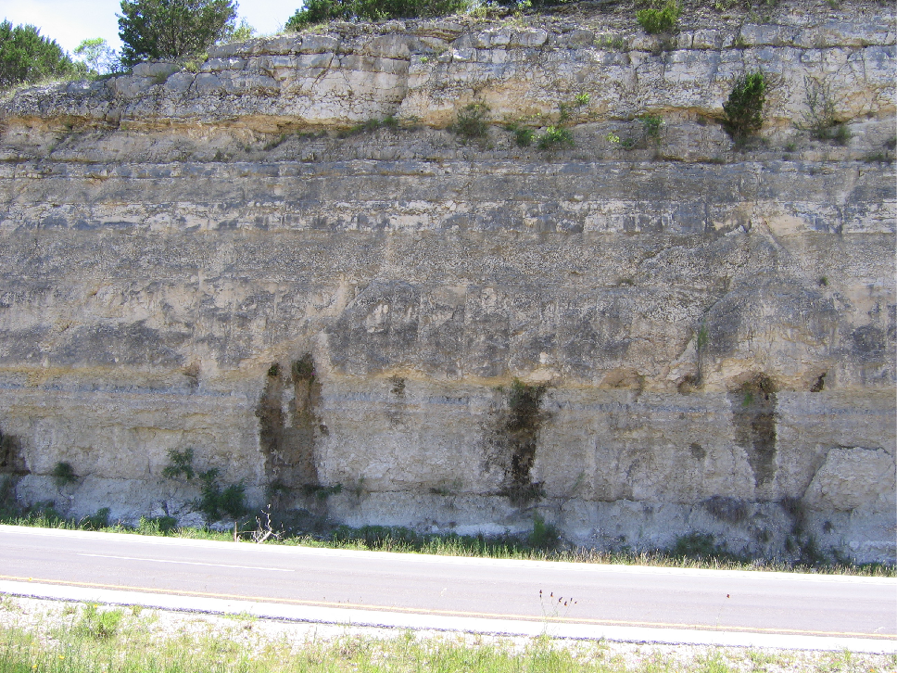
Edwards-Trinity (Plateau) Aquifer, limestone
Notes:
Edwards-Trinity Plateau Aquifer (Fort Terrett Mbr), Interstate 10 near Kerrville

Slide 13
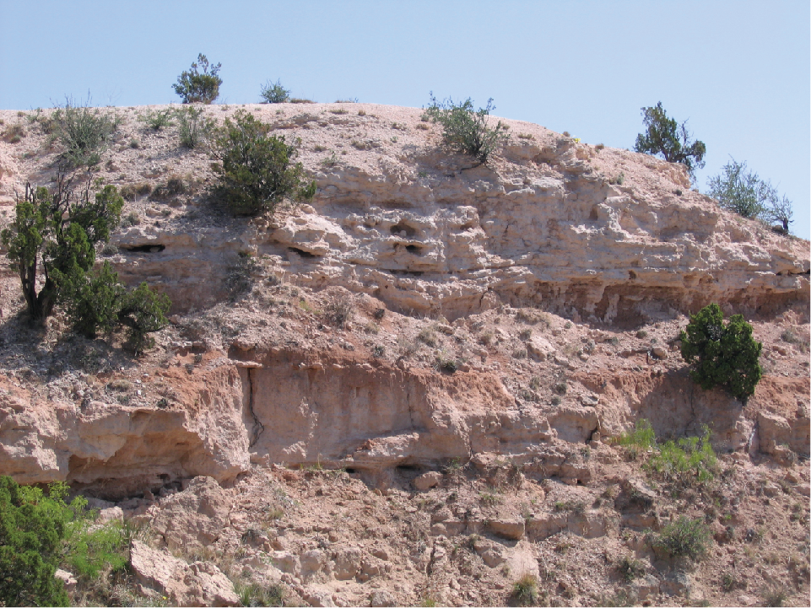
Ogallala Aquifer, sand and gravel
Notes:
Ogallala Aquifer near the entrance to Palo Duro Canyon State Park

Slide 14
what is an aquifer?
an aquifer is geologic media that can yield economically usable amounts of water.
Fill in the definition in your notes
Dirt and rocks
Depends on
who’s using it

Slide 15

Aquifers have certain properties:
Limestone (especially karstified),
sandstone, sand, gravel, fractured rocks
It must have spaces that water can fill up;
These spaces are called pores. We call these
Materials porous. (The related noun is porosity)
It is measured by volume of space/total volume of material.

Slide 16
Porosity - The amount of space in between sediments.
Porosity is determined by:
1. Shape - Well rounded particles have greater porosity than angular.
POROSITY
ROUND
ANGULAR
ROUNDNESS

Slide 17
2. PACKING- The more closely packed the particles the lower the porosity.
POROSITY
PACKING
UNPACKED
PACKED

Slide 18
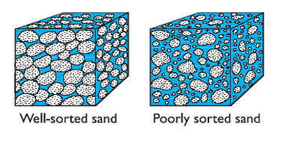
3. SORTING-
- If all particles are the same size they are sorted.
- If the particles are different sizes they are
unsorted (poorly sorted)
- The more sorted the higher the porosity
POROSITY
SORTING

Slide 19
what is an aquifer?
For a layer to be a true aquifer, it must
Allow water to flow; if a layer lets water flow,
We say its permeable. (The related noun is
Permeability.)
This is how interconnected the pores are.

Slide 20
Permeability
Ability of water to pass through
Affected by: packing and particle size
Tighter packing and Smaller particles = less permeability
Looser Packing and
Larger particles =
more permeability
PERMEABILITY
PARTICLE
SIZE

Slide 21
Other things about Permeability
Permeability Rate – How fast a fluid can flow through a material
Impermeability (not permeable) is due to:
A. Tightly packing of particles
B. Cementing of particles by clay
C. Cementing of particles by ice

Slide 22
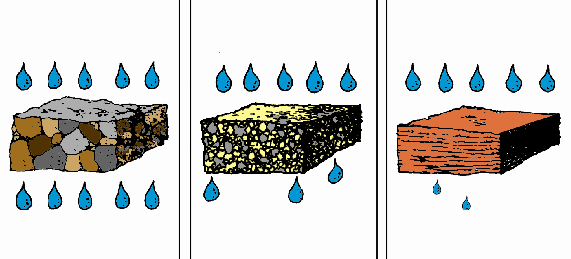
PERMEABILITY
GRAVEL Rapid drainage | FINE SAND Moderate drainage | CLAY Slow drainage

Slide 23
Clay is impermeable – water will not flow through easily

Slide 24
what is an aquitard?
Another characteristic of most aquifers is the presence of layers that don’t let water flow easily.
an aquitard is geologic media that can not yield economically usable amounts of water.

Slide 25

what is an aquitard?
clay, shale, unfractured dense rocks
Note: can still transmit water,
but s l o w l y

Slide 26
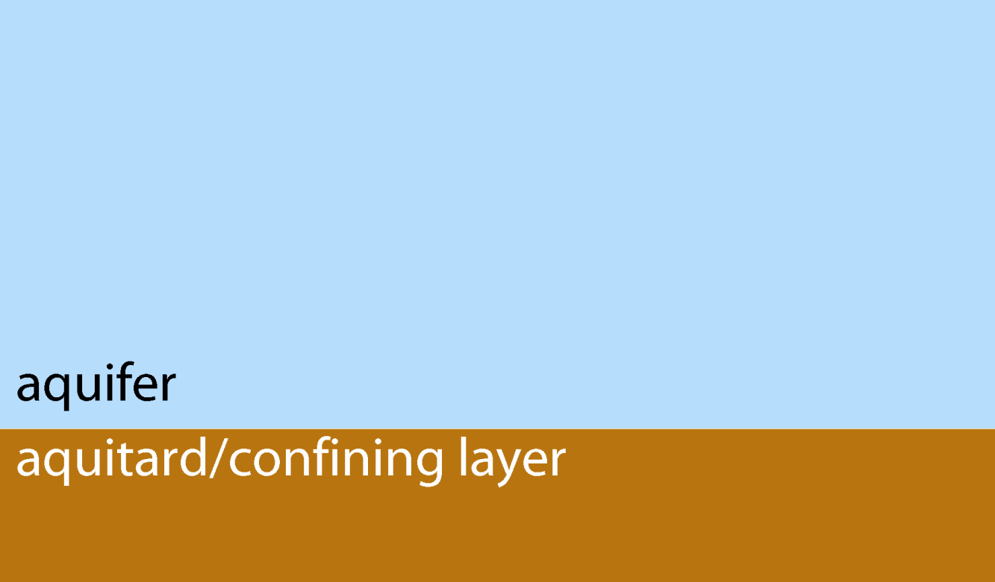
what is a confining layer?
A confining layer is an aquitard that bounds an aquifer.
Notes:
Geologic layers in love

Slide 27
what is a vadose zone?
The vadose zone is the unsaturated geologic media between the water table and the land surface.
Scientific side note: There is a saturated capillary zone between the vadose zone and the water table.

Slide 28
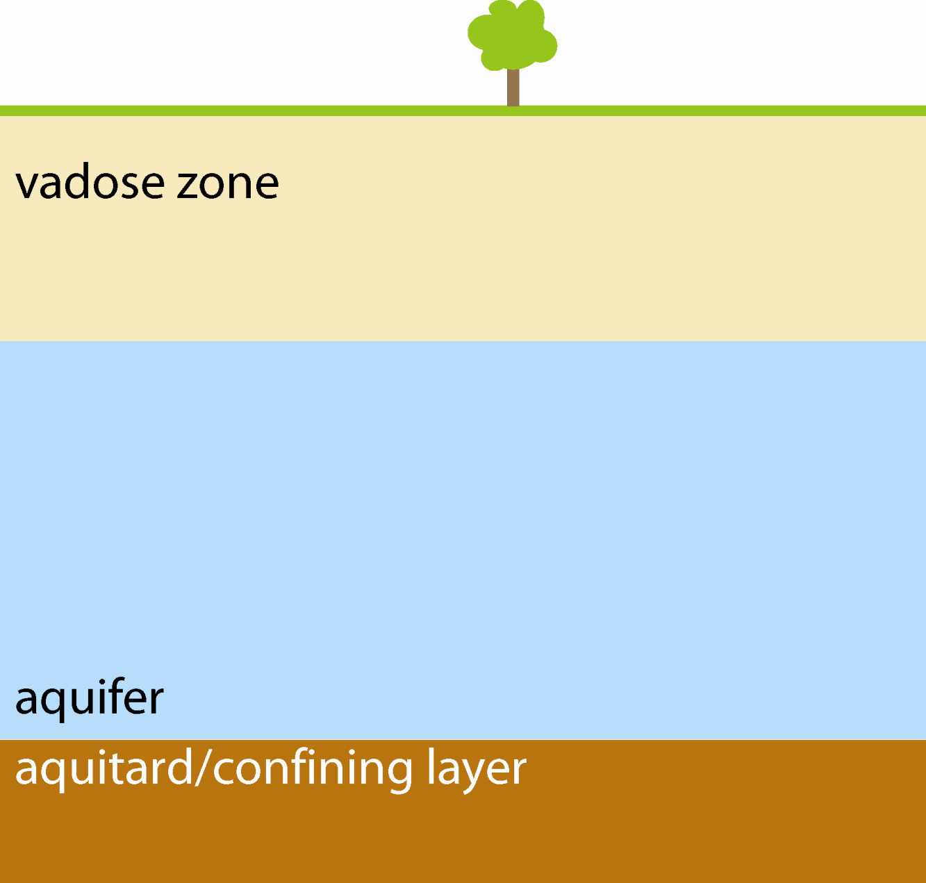
the vadose zone

Slide 29
what is a water table?
A water table is where the aquifer meets the vadose (unsaturated) zone.
Scientific definition: surface on which the fluid pressure in the pores of a porous medium is exactly atmospheric.

Slide 30
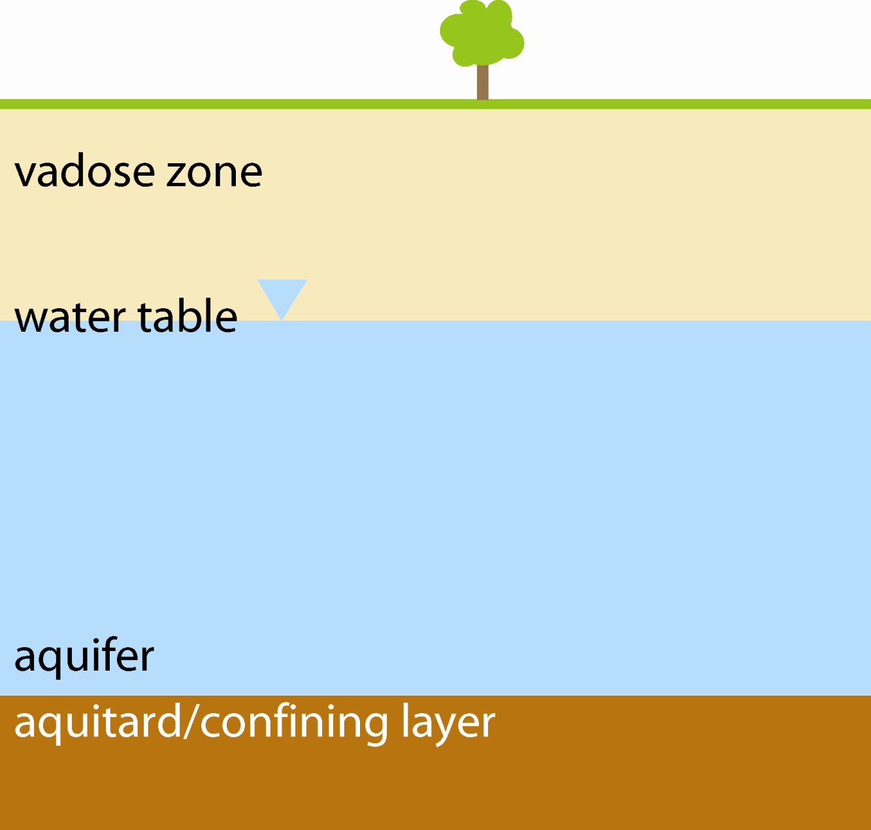
the water table
Notes:
Capillary zone

Slide 31
what is recharge?
Recharge is water that infiltrates to the water table of an aquifer.

Slide 32
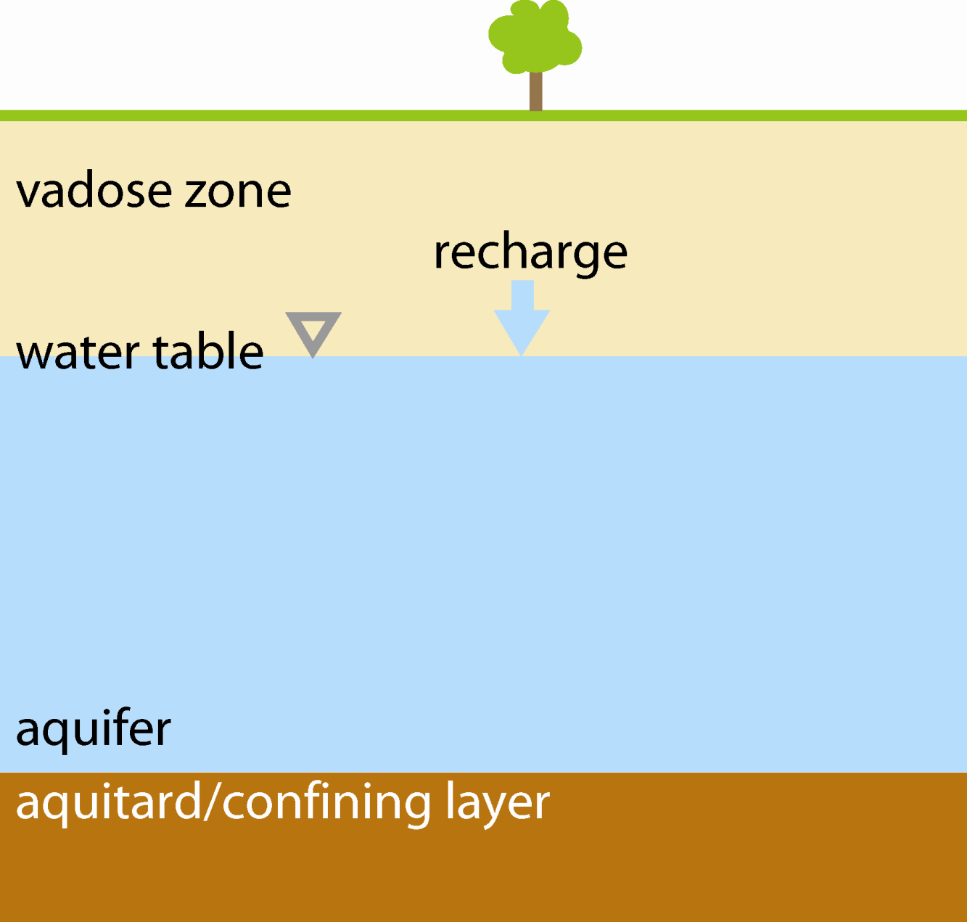
recharge

Slide 33
what is a water level?
A water level is the level at which water rests (or would rest) in a well.

Slide 34
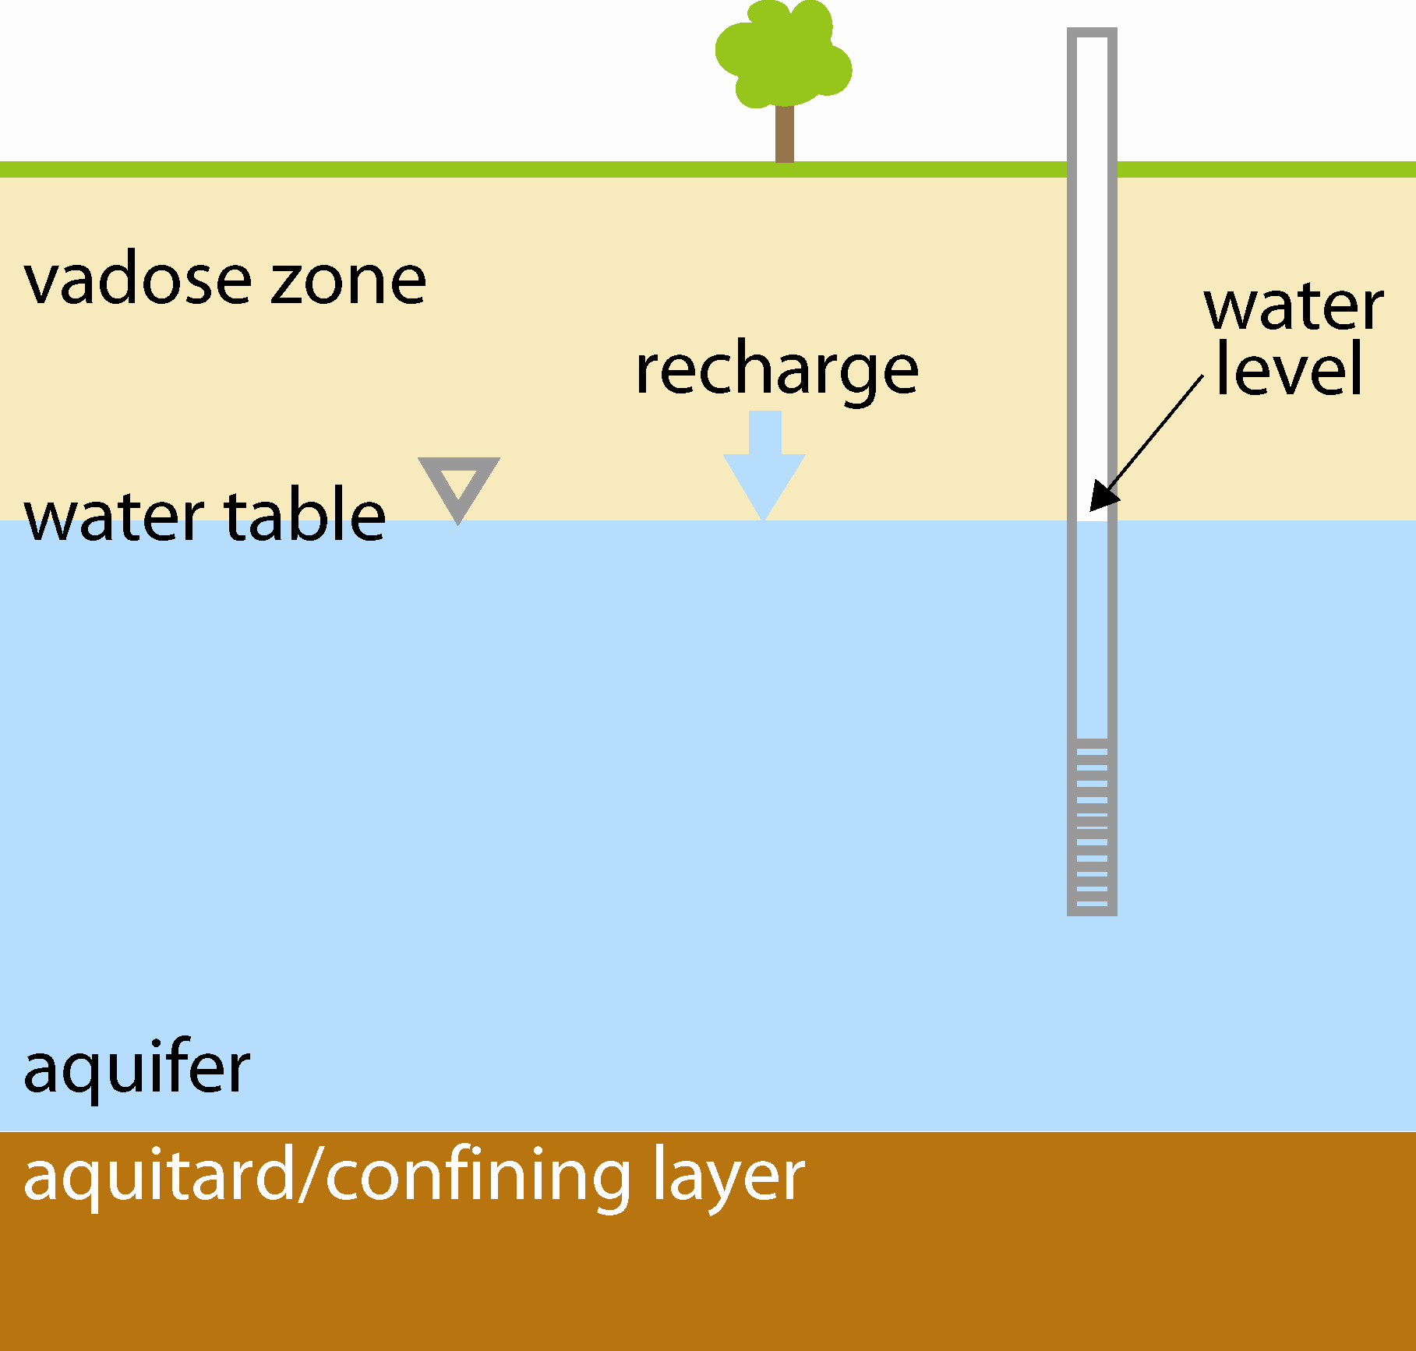
the water level
Notes:
Dipstick
Also tells which way water may be going…

Slide 35
2 rules of groundwater flow
water flows downhill (to lower potential energy)
water flows uphill to money

Slide 36
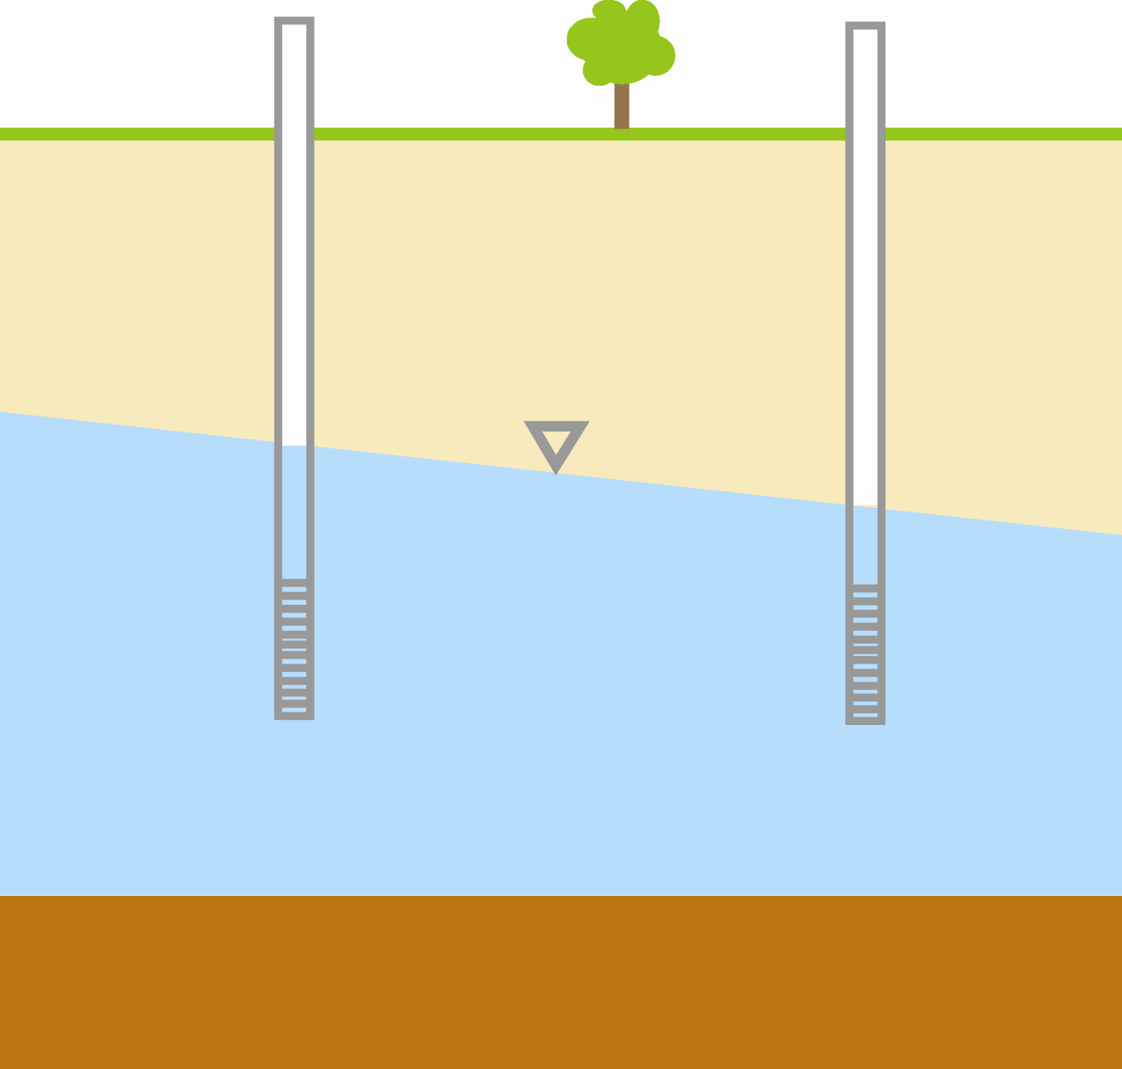
water flows downhill (to lower potential energy)

Slide 37
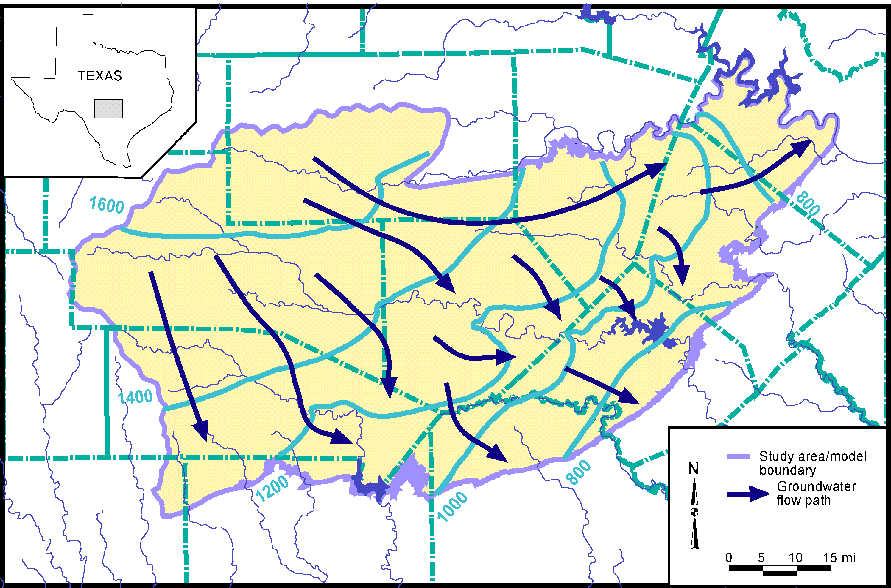
Groundwater Flowpaths

Slide 38
what is an unconfined aquifer?
An unconfined aquifer is an aquifer that is bounded by a confining layer at its bottom but not at its top.

Slide 39

an unconfined aquifer

Slide 40
what is a confined aquifer?
A confined aquifer is an aquifer that is bounded by confining layers at its bottom and top and where the water level rises above the top of the aquifer.
Scientific side note: This is also an artesian aquifer. “Artesian” does not require water to flow at land surface.

Slide 41
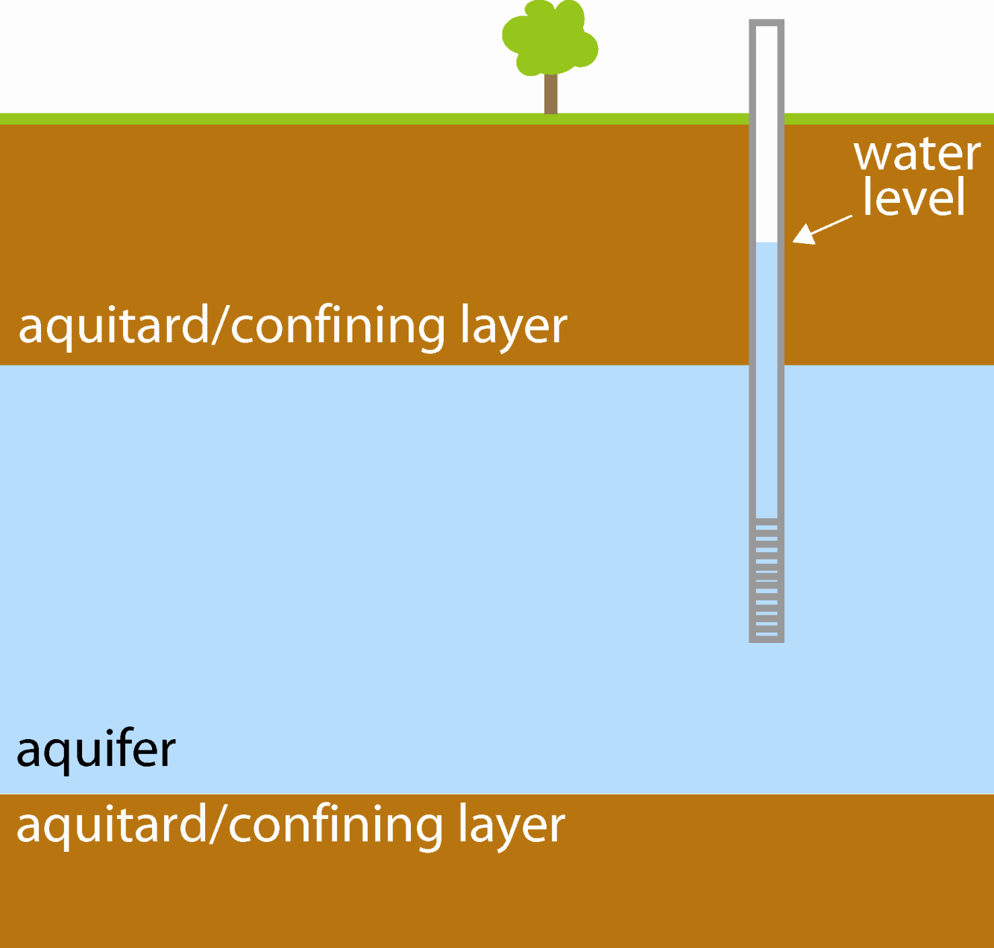
a confined aquifer
Notes:
Menage a tua

Slide 42
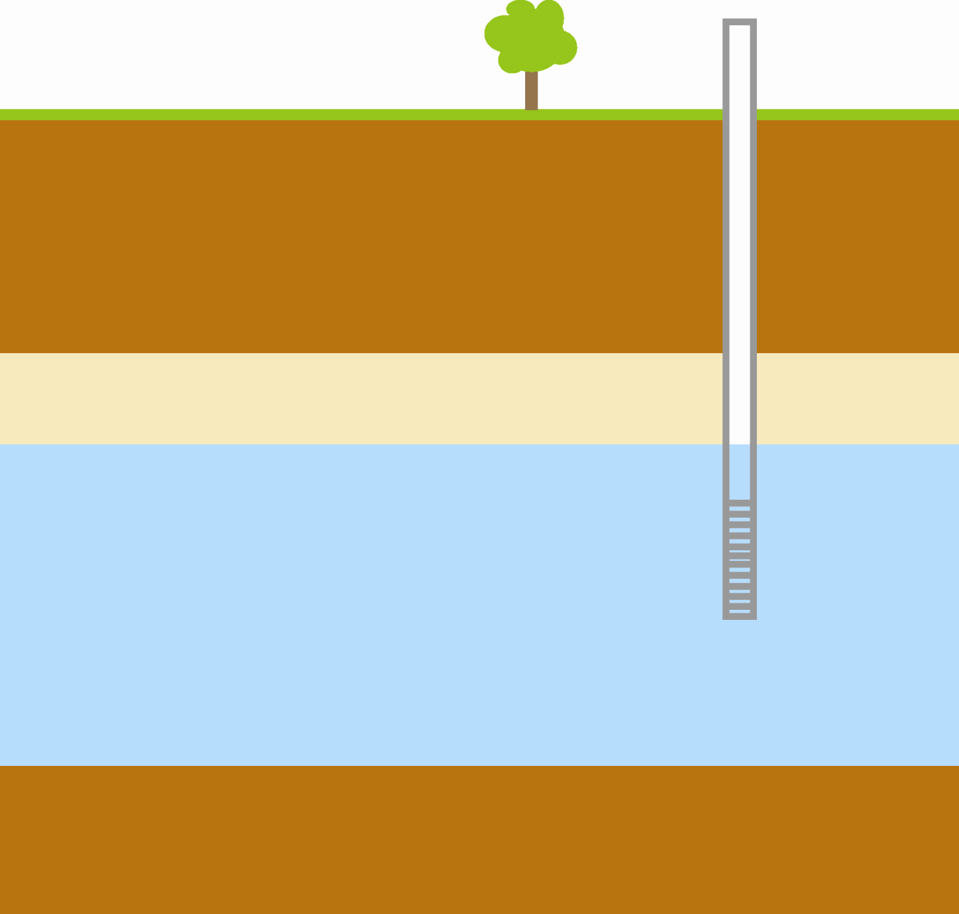
confined or unconfined?
Notes:
Menage a tua

Slide 43
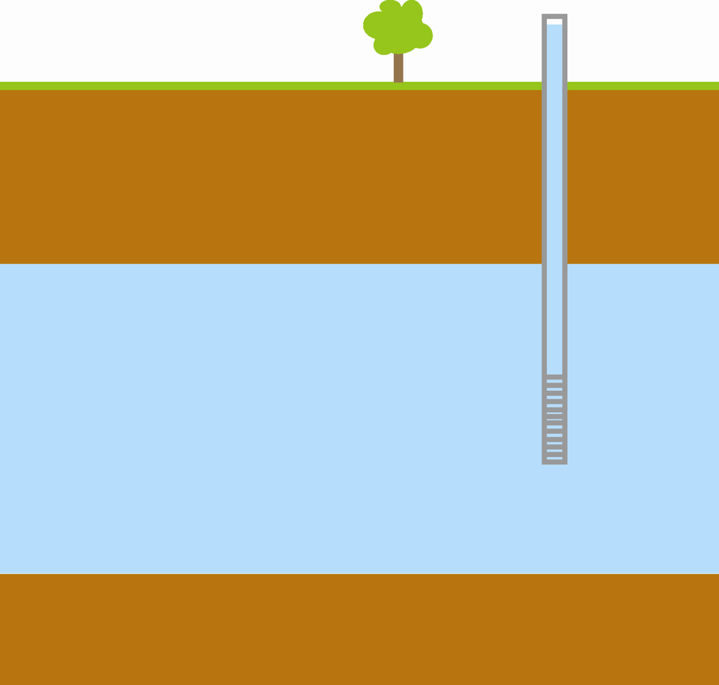
confined or unconfined?
Notes:
Menage a tua

Slide 44
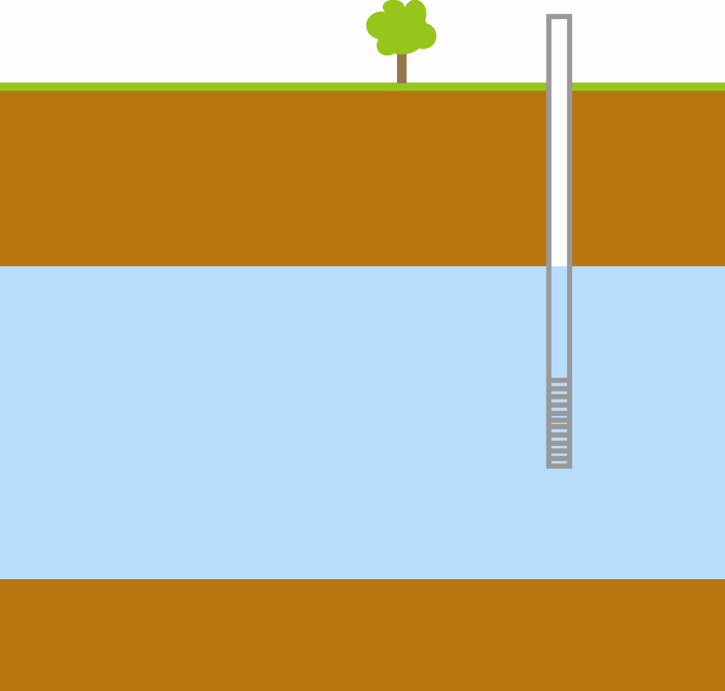
confined or unconfined?
Notes:
Menage a twa

Slide 45
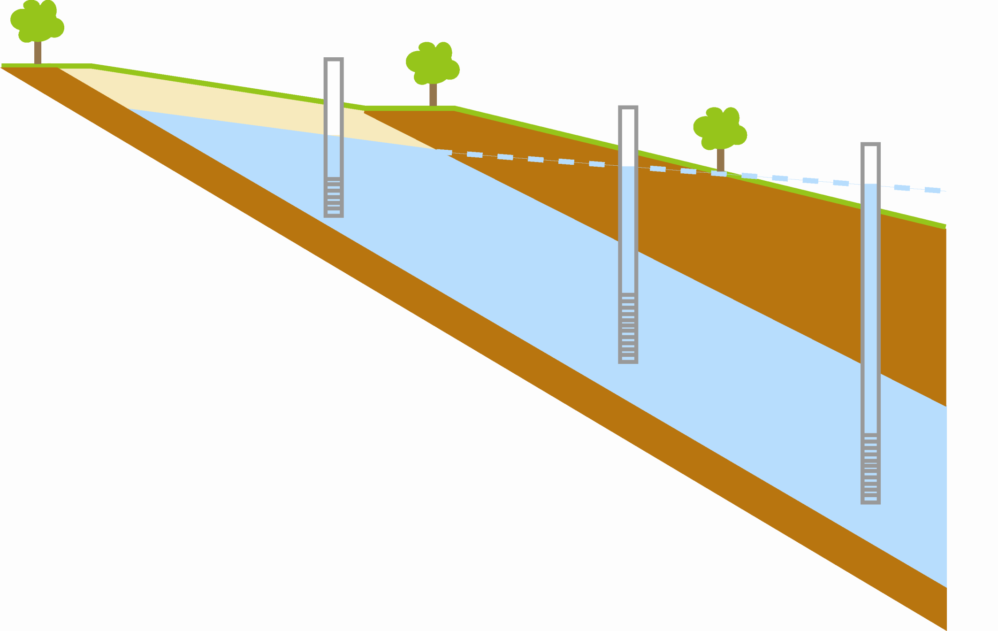
same aquifer: unconfined and confined
Notes:
Which way is the water flowing?

Slide 46
Major aquifers

Slide 47
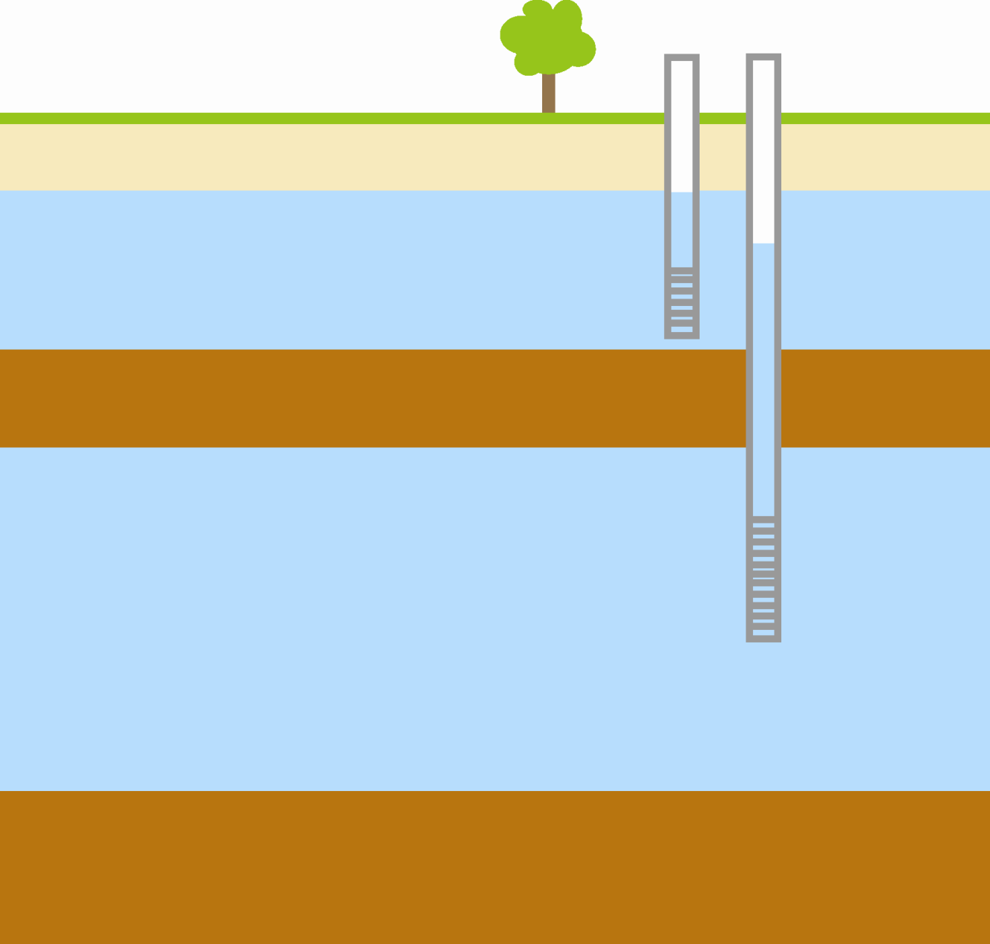
same location: confined and unconfined aquifers

Slide 48
Outline
Yay for aquifers!
Definitions
Flow through an aquifer
Pumping an aquifer

Slide 49
Your aquifer
as a bathtub
Spring/
base
flow
Recharge
Aquifer
Pumping
Notes:
Mention availability: recharge and storage in the tub
Paradox of availability

Slide 50
Notes:
- controls:
precipitation
runoff
evapotranspiration
infiltration
transmissivity (explain)
streams, rivers, springs
evapotranspiration
pumping
cross-formational flow

Slide 51
cross-section - structure
Notes:
When I say structure, what I mean is where the aquifer is underground.
Structure is critical for modeling
Explain figure
Many minor aquifers do not have good structure.

Slide 52
Your aquifer
as a bathtub
Spring/
base
flow
Recharge
Aquifer
Pumping

Slide 53
recharge

Slide 54
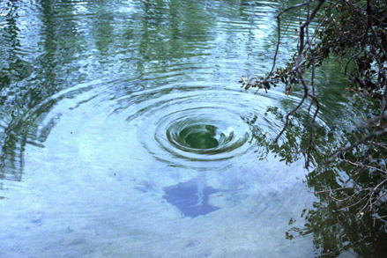

Slide 55
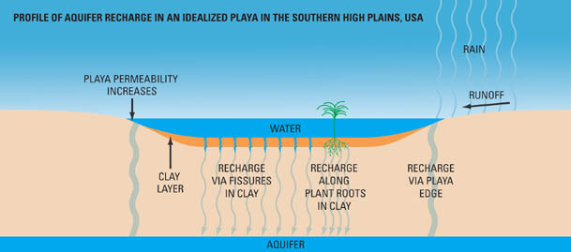
Graphic from Playa Lakes Joint Venture

Slide 56
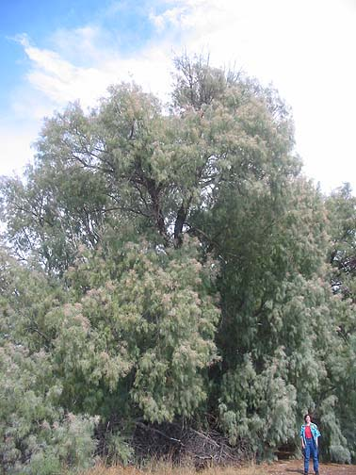
Attack of the
Killer
Salt Cedar!

