Slide 1
Atomic Structure
A BohrRing Activity
#MsTasneemissofunny
If the top of the slide says atomic structure notes (the information should go on your notes sheet)
If the top of the slide has a roman numeral, it is the instructions for the bohr ring activity sheet and cards
Slides 1-17 are review (we did this last class)
Start with slide #18 and confirm your answers for part I and II

Slide 2
Atomic Structure Notes
What is the term used to describe anything that has mass and takes up space?

Slide 3
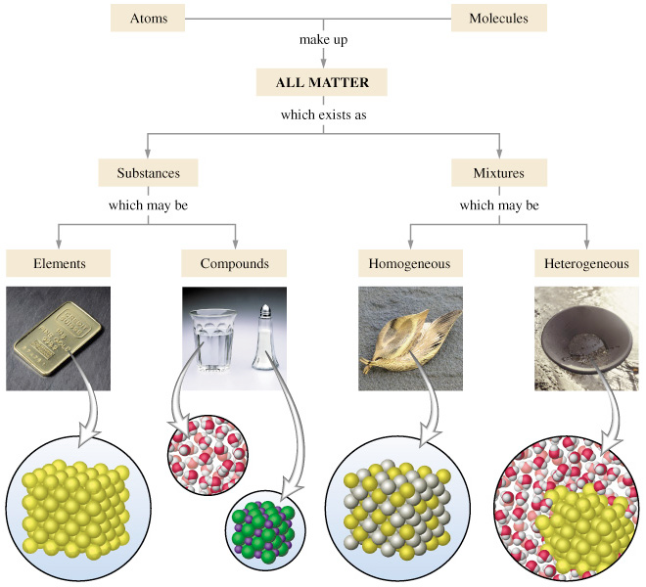
Notes:
Photo credit: http://www.google.com/search?q=classification+of+matter&safe=active&client=firefox-a&hs=EhN&rls=org.mozilla:en-US:official&source=lnms&tbm=isch&sa=X&ei=hTrQUoSuGIjPsATYw4DgCw&ved=0CAkQ_AUoAQ&biw=1280&bih=867&surl=1#facrc=_&imgdii=_&imgrc=k9s93wLjOeyUCM%253A%3B53Kk9bpDl-pvLM%3Bhttp%253A%252F%252Fcwx.prenhall.com%252Fbookbind%252Fpubbooks%252Fhillchem3%252Fmedialib%252Fmedia_portfolio%252Ftext_images%252FCH01%252FFG01_03.JPG%3Bhttp%253A%252F%252Fwww.kentchemistry.com%252Flinks%252FMatter%252FClassifiyingMatter.htm%3B660%3B600

Slide 4
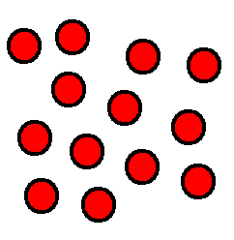
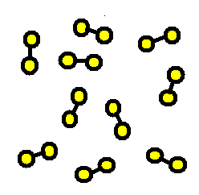
What is an element?
A substance composed of a single kind of atom.
Cannot be broken down into another substance by chemical or physical means.
Notes:
Credit to 7th grade science notes

Slide 5
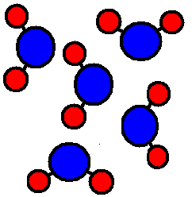
What is a compound?
A substance in which two or more different elements are CHEMICALLY bonded together.

Slide 6
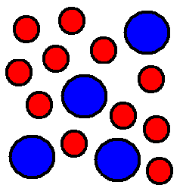
What is a MIXTURE?
Two or more substances that are mixed together but are NOT chemically bonded.

Slide 7
If the photos are….
Elements- jump up and down
Compounds- Stay in your chair
Mixture- Move to the middle of the room

Slide 8
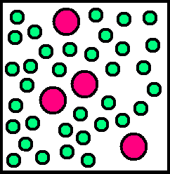
Element, Compound or Mixture?

Slide 9
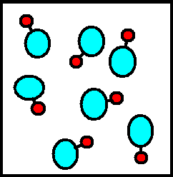
Element, Compound or Mixture?

Slide 10
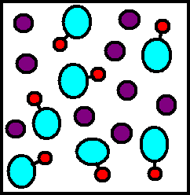
Element, Compound or Mixture?

Slide 11
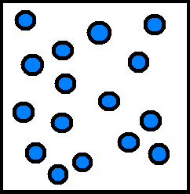
Element, Compound or Mixture?

Slide 12
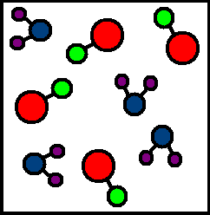
Element, Compound or Mixture?

Slide 13
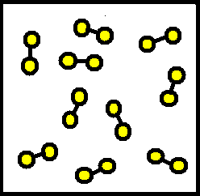
Element, Compound or Mixture?

Slide 14
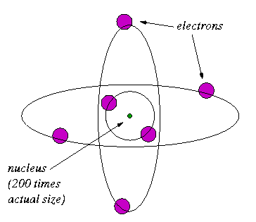
Main Components of the Atom
Proton p⁺
Electron e⁻
Neutron n⁰
(Nucleus- p⁺ and n⁰)

Slide 15
Electron Shells –layers or orbits surrounding the nucleus where electrons exist
1st shell has two electrons, 2nd and 3rd shell has eight, larger numbers of electrons fill the outer shells
Atoms/elements are more stable if their outer shell is full.

Slide 16
What does a periodic table tell you?
Atomic number
2
He
4
Atomic mass

Slide 17
What does a Chemical Symbol tell you?
He
4
2

Slide 18
I. Protons – use the white cards
Use the white cards and your periodic table to:
Fill in the information for both tables in #1
Answer #2 using the tables from #1
Answer #3 using the back of the bohr cards and your periodic table (you could also look at the notes we just took)
Answer #4

Slide 19
Atomic Structure Notes
Protons:
Determine an atom’s identity (personality)
# of protons = atomic number
# of protons = # of electrons FOR NEUTRAL ATOMS
Placement varies on periodic tables
# always to the bottom left of a chemical symbol

Slide 20
II. Neutrons (Use the white cards)
Use the white cards from part I. and your periodic table to:
Fill in the table for #1 (the other part of it is on the first page)
You are missing cards for K and Ca
Answer #5a, we will answer #5b next class
Answer #6

Slide 21
Atomic Structure Notes
Neutrons:
Help determine mass
Atoms of the same element can have different #’s of neutrons
# of neutrons = Atomic mass # - Atomic #
Atomic mass = neutrons + protons

Slide 22
III. Isotopes (pink cards)
Use the pink cards that have chemical symbols followed by dashes followed by numbers to:
Fill in the table for #7
Answer #8a and #8b
Answer #9
Answer #10

Slide 23
Atomic Structure Notes
Isotopes
Same # of protons, different # of neutrons
Affect mass of atoms of the same element

Slide 24
IV. Electrons (use the white cards)
Use the white cards
Fill in the table for #11
Answer #12
Answer #13

Slide 25
Atomic Structure Notes
Electrons:
# Electrons = # protons FOR NEUTRAL ATOMS
If # of electrons changes, there will be an overall charge
Determine charge of the atom

Slide 26
V. Ions (use the orange cards)
Use the orange cards to
Fill in the table for #14
Skip the information for Ca (you do not have cards for Ca)
Answer #15-17 using the matching neutral bohr cards from parts I. and II.
Fill in the table

Slide 27
Atomic Structure Notes
Charge = protons + electrons
Charged atoms are called ions

Slide 28
Who is APEMAN?
Atomic # is
Protons and
Electrons (neutral atoms)
Mass number minus
Atomic # is
Neutrons

