Slide 1
Canstruction Challenge!
A chance for advisories to build and design sculptures entirely from non-perishable food

Slide 2
RULES
You may use any non-perishable food items (they do not have to be just cans).
You may NOT use glue, tape, rubber cement or anything else to hold the cans together.
You may use paper or cardboard.
You may NOT just stack the goods.
You may use your imagination, have fun and donate all the goods to Capital Area Food Bank.
You have until Tuesday, November 19 to build and design your sculpture.
Sculptures and awards will be given on Tuesday, November 22.

Slide 3
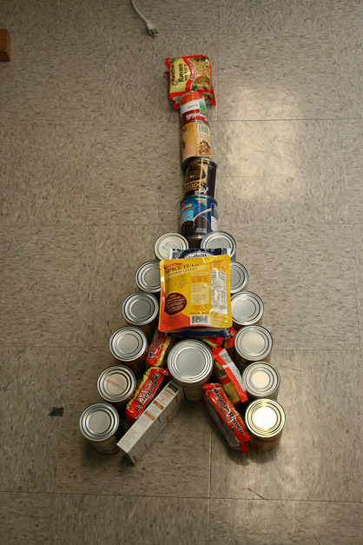
Sculptures from the Past

Slide 4
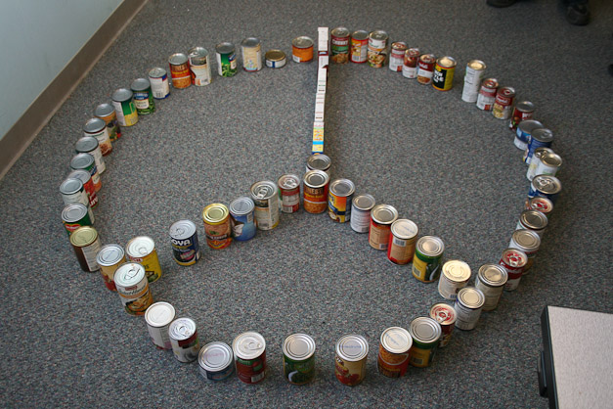

Slide 5
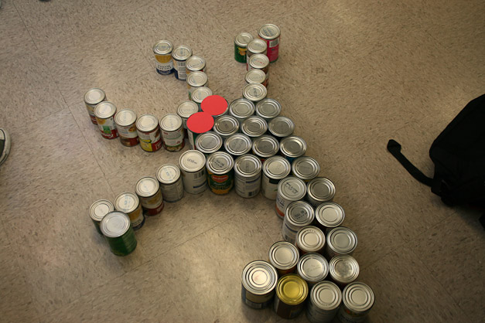

Slide 6
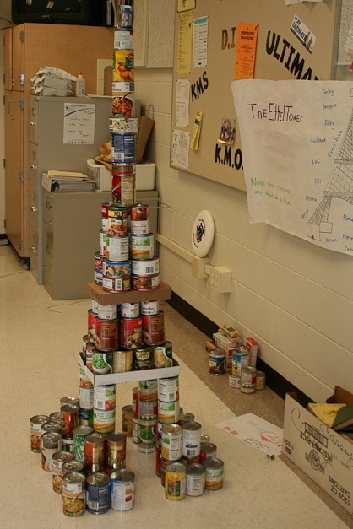

Slide 7
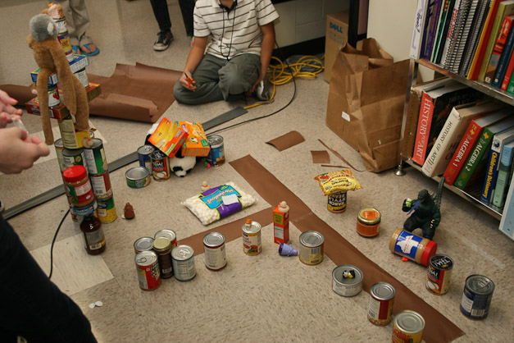

Slide 8
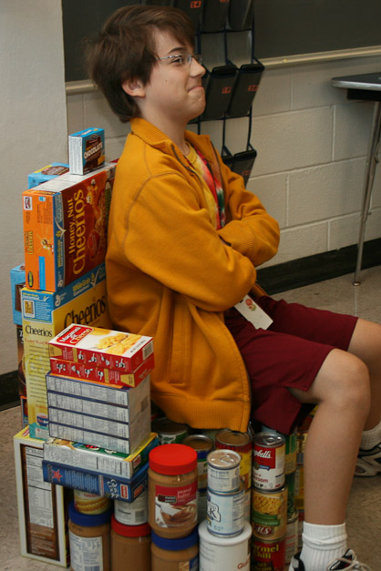

Slide 9
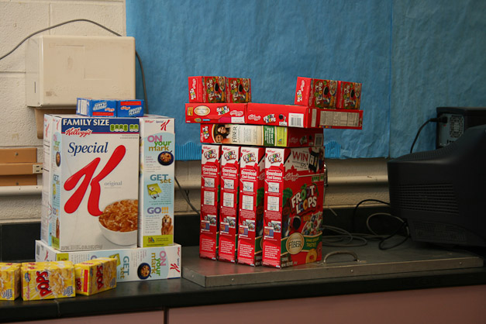

Slide 10
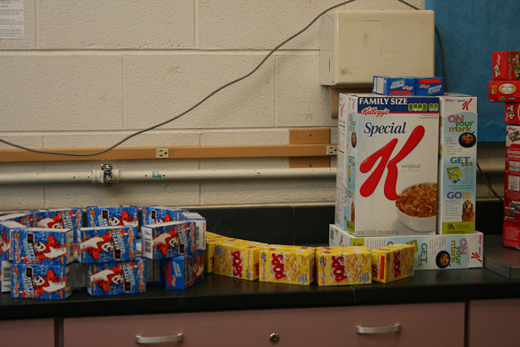

Slide 11
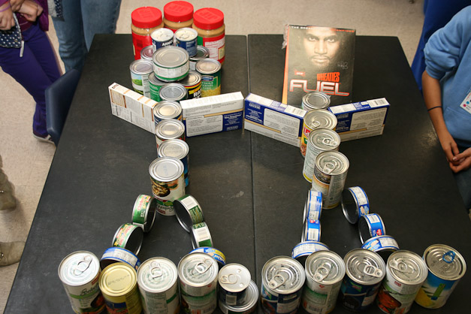

Slide 12
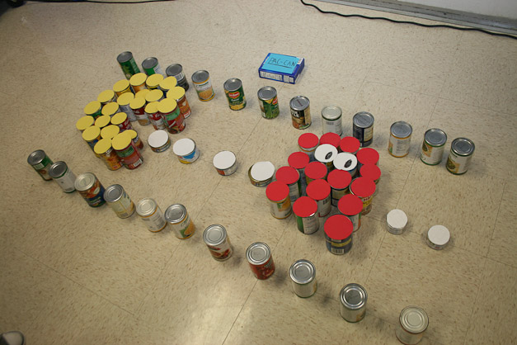

Slide 13
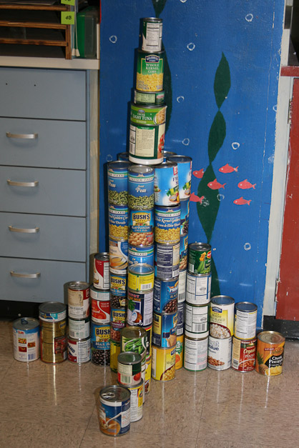

Slide 14
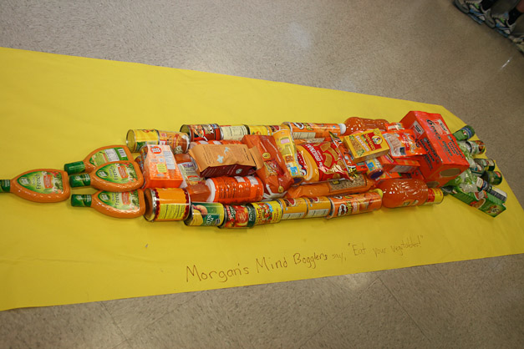

Slide 15
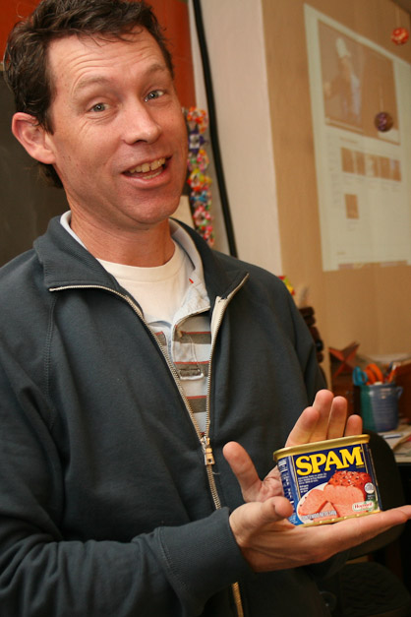
Did not win an award

Slide 16
Your Challenge: Even Bigger and Better!

Slide 17
http://www.austinfoodbank.org/events/signature/canstruction//

