Slide 1
What is a chemical reaction?
Find this reaction:
Na₂SO₄ + CaCl₂ → CaSO₄ + 2 NaCl
Label the things we know (or should know anyway):
Circle the subscripts; describe how many of each atom you have using subscripts
List AND NAME the chemical formulas
For each compound, identify the cation, anion, and any polyatomic ions (with the correct oxidation state)

Slide 2
What don’t we know about chemical reactions?
Find the chemical reaction:
Ca_{(s)} + 2H₂O_{(aq)} → Ca(OH)_{2(aq)} + H_{2(g)}
Discuss with your group (3 minutes):
What do the big numbers (coefficients) in front of the compounds mean?
How do you think states of matter are represented in chemical reactions?
Which side of the arrow would we find reactants? Which side of the arrow would we find products?
What do we call elements that bond with themselves and are found in pairs?

Slide 3
Grouping Reactions
Group these reactions into 5 different groups
HINT: All reactions in the same group have similar patterns on the reactant and product side. Try to focus on how elements/atoms/polyatomics are “moving” in the reaction.
RULES:
You cannot simply say these all have Oxygen in them. Be specific! Ex: All of these reactions have two reactants (one of them is oxygen) and one product with oxygen.
You cannot use the coefficients, subscripts, how the paper was cut, or states of matter as part of your criteria

Slide 4
Types of Reactions
There are five types of chemical reactions we will talk about:
Synthesis reactions
Decomposition reactions
Single displacement reactions
Double displacement reactions
Combustion reactions
Today’s Goal: Identify the type of reaction predict the product(s), AND BALANCE THE EQUATIONS!

Slide 5
Steps to Writing Reactions
Some steps for doing reactions
Identify the type of reaction
Predict the product(s) using the type of reaction as a model
Balance it
Don’t forget about the diatomic elements! (all the halogens and H,O,N) For example, Oxygen is O₂ as an element.
In a compound, it can’t be a diatomic element because it’s not an element anymore, it’s a compound!

Slide 6
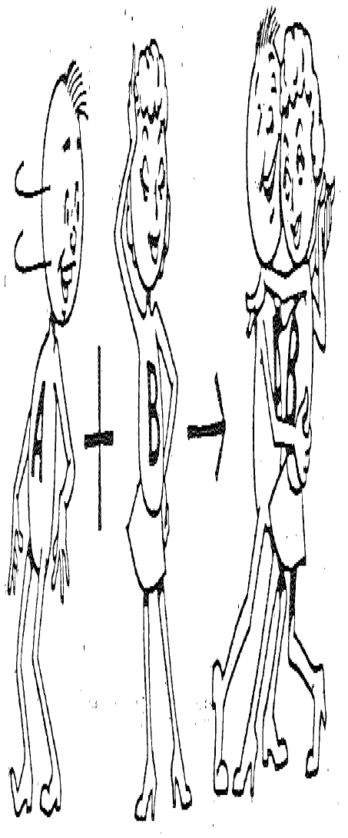
1. Synthesis reactions
Synthesis reactions occur when two substances (generally elements) combine and form a compound. (Sometimes these are called combination or addition reactions.)
reactant + reactant → 1 product
Basically: A + B → AB
Example: 2H₂ + O₂ → 2H₂O
Example: C + 2H₂ → CH₄

Slide 7
Predicting Products Practice
Predict the products for the following synthesis reaction equations by writing the correct chemical formula on the right side of the arrow:
REMEMBER TO USE THE CRISS CROSS METHOD!
Sodium metal reacts with chlorine gas
Na_{(s)} + Cl_{2(g)} →
Solid Magnesium reacts with fluorine gas
Mg_{(s)} + F_{2(g)} →
Aluminum metal reacts with fluorine gas
Al_{(s)} + F_{2(g)} →

Slide 8
2. Decomposition Reactions
Decomposition reactions occur when a compound breaks up into the elements or in a few to simpler compounds
1 Reactant → Product + Product
In general: AB → A + B
DEMO: H₂O₂ → 2H₂O + O₂
Example: 2 HgO → 2Hg + O₂

Slide 9
Decomposition Exceptions
Carbonates and chlorates are special case decomposition reactions that do not go to the elements.
Carbonates (CO₃²⁻) decompose to carbon dioxide and a metal oxide
Example: CaCO₃ → CO₂ + CaO
Chlorates (ClO₃⁻) decompose to oxygen gas and a metal chloride
Example: 2 Al(ClO₃)₃ → 2 AlCl₃ + 9 O₂
There are other special cases, but we will not explore those

Slide 10
Practice
Predict the products for the following decomposition reactions by writing the correct chemical formula on the right side of the arrow: REMEMBER DIATOMIC MOLECULES!
Solid Lead (IV) oxide decomposes PbO_{2(s)} →
Aluminum nitride decomposes
AlN_{(s)} →

Slide 11
3. Single Replacement Reactions
Single Replacement Reactions occur when one element replaces another in a compound.
A metal can replace a metal (+) OR a nonmetal can replace a nonmetal (-).
element + compound→ product + product
A + BC → AC + B (if A is a metal) OR
A + BC → BA + C (if A is a nonmetal)
(remember the cation always goes first!)
When H₂O splits into ions, it splits into
H⁺ and OH⁻ (not H+ and O⁻² !!)

Slide 12
Single Replacement Reactions
Predict the products for the following single replacement reactions by writing the correct chemical formula on the right side of the arrow: USE THE CRISS-CROSS METHOD!
DEMO: Zinc metal reacts with aqueous hydrochloric acid
Zn_{(s)} + 2 HCl_{(aq)} →
Think about whether zinc will replace H or Cl? Why?

Slide 13
Single Replacement Reactions
Sodium chloride solid reacts with fluorine gas
NaCl_{(s)} + F_{2(g)} → NaF_{(s)} + Cl_{2(g)}
Note that fluorine replaces chlorine in the compound
Calcium metal reacts with water to form
Ca_{(s)}+ H₂O_{(aq)}→ Ca(OH)_{2 (s)} + H_{2 (g)}
2
2

Slide 14
4. Double Replacement Reactions
Double Replacement Reactions occur when a metal replaces a metal in a compound and a nonmetal replaces a nonmetal in a compound
Compound + compound → product + product
AB + CD → AD + CB

Slide 15
Double Replacement Reactions
Think about it like “foil”ing in algebra, first and last ions go together + inside ions go together
DEMO:
AgNO_{3(aq)} + NaCl_{(s)} → AgCl_{(s)} + NaNO_{3(aq)}
Another example:
K₂SO_{4(aq)} + Ba(NO₃)_{2(aq)} → KNO_{3(aq)} + BaSO_{4(s)}
2

Slide 16
Practice
Predict the products for the following double replacement reactions by writing the correct chemical formula on the right side of the arrow: USE THE CRISS-CROSS METHOD AND THE “FOIL” METHOD!
HCl_{(aq)} + AgNO_{3(aq)} →
CaCl_{2(aq)} + Na₃PO_{4(aq)} →
Pb(NO₃)_{2(aq)} + BaCl_{2(aq)} →
FeCl_{3(aq)} + NaOH_{(aq)} →
H₂SO_{4(aq)} + NaOH_{(aq)} →
KOH_{(aq)} + CuSO_{4(aq)} →

Slide 17
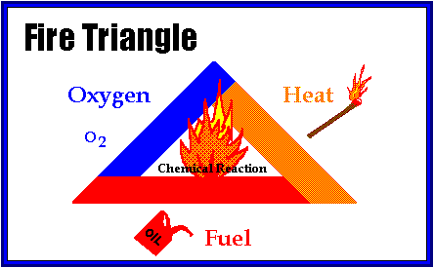
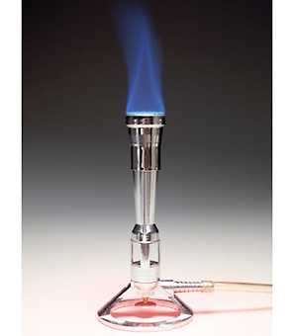
5. Combustion Reactions
Combustion reactions occur when a hydrocarbon reacts with oxygen gas.
This is also called burning!!! In order to burn something you need the 3 things in the “fire triangle”: 1) A Fuel (hydrocarbon) 2) Oxygen to burn it with 3) Something to ignite the reaction (spark)

Slide 18
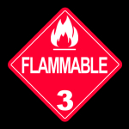
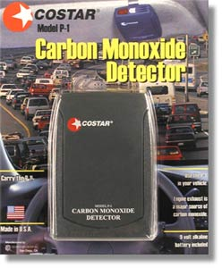
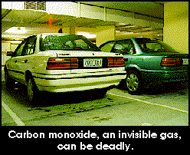
Combustion Reactions
In general: C_{x}H_{y} + O₂ → CO₂ + H₂O
Products in combustion are ALWAYS carbon dioxide and water. (although incomplete burning does cause some by-products like carbon monoxide)
Combustion is used to heat homes and run automobiles (octane, as in gasoline, is C₈H₁₈)

Slide 19
Combustion
DEMO:
C₃H₈ + 5O₂ → 3CO₂ + 4H₂O
Predict the products for the following double replacement reactions by writing the correct chemical formula on the right side of the arrow: USE THE REACTION TYPE TO HELP YOU!
C₁₀H₂₂ + O₂ →

Slide 20
Reaction Flow Chart
1) Is O₂ a reactant? (combustion)
2) One product? (synthesis)
3) One reactant? (decomposition)
4) Is an element being replaced? (single)
5) 2 switches? (double)
NEXT Time: Balancing chemical reactions

Slide 21
How do we know that a chemical reaction has occurred?
Create gas
Increase in temperature
Decrease in temperature
Precipitate formed
Produce light

Slide 22
Mixed Practice
State the type of reaction, predict the products by writing the correct chemical formulas on the right side of the arrow:
BaCl₂ + H₂SO₄ →
C₆H₁₂ + O₂ →
Zn + CuSO₄ →
Cs + Br₂ →
FeCO₃ →

