Slide 1
Climate Changes
Past and Future

Slide 2
Defining Climate Change
Response of Earth-atmosphere system to changes in boundary conditions
What external factors might drive changes in climate?
Intensity of sunlight
Arrangement of continents and oceans
Composition of atmosphere

Slide 3
The Time Scales of Climate Change
Is the climate warming?
What does this answer depend on?

Slide 4
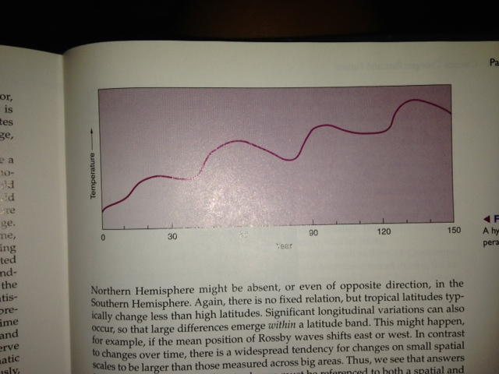
Is the Climate Warming?

Slide 5
Past Climates
Using the geologic time scale as a calendar
Identify points in time
Not particular climates or events

Slide 6
Warm Intervals and Ice Ages
Our planet has been warmer than it is today
Earth has been free of permanent ice for most of its life
Warm times persists for hundreds of millions of years to billions of years
Ice ages last on the order of tens of millions to perhaps a hundred million

Slide 7
Ice Ages
Earliest dates to 2.3 billion years ago
900 to 600 million years ago
Others 440 MYA and 300 MYA
Most recent 55 MYA

Slide 8
What is Paleoclimatology?
Paleoclimatology is the study of climate prior to the period of instrumental measurements

Slide 9
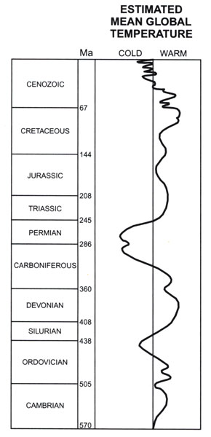
Temperatures over last 570 million years
Earth is ~4.6 billion years old
Further back one goes in Earth history, the more uncertain are our estimates of temperature
Notes:
Bradley Fig.1.1
Churchill quote
"The farther backward you can look, the farther forward you are likely to see." - Winston Churchill

Slide 10
Temperatures over last 570 million years
Warm period of dinosaurs
Extensive glaciation of supercontinent of Pangea
Indications that Earth was much warmer and much colder than present
Notes:
Bradley Fig.1.1
Churchill quote
"The farther backward you can look, the farther forward you are likely to see." - Winston Churchill

Slide 11
Temperatures over last 570 million years
Warm period of dinosaurs
Extensive glaciation of supercontinent of Pangea
"The farther backward you can look, the farther forward you are likely to see." - Winston Churchill
Notes:
Bradley Fig.1.1
Churchill quote
"The farther backward you can look, the farther forward you are likely to see." - Winston Churchill

Slide 12
Tools for studying past climates
Data: Natural recorders of climate or proxy data
Climate models*: Understand relationships between external forcings and climate system
* NCAR Climate System Model or CSM
Notes:
Have data description fly in
Impt if want to know shat future changes we might expect

Slide 13
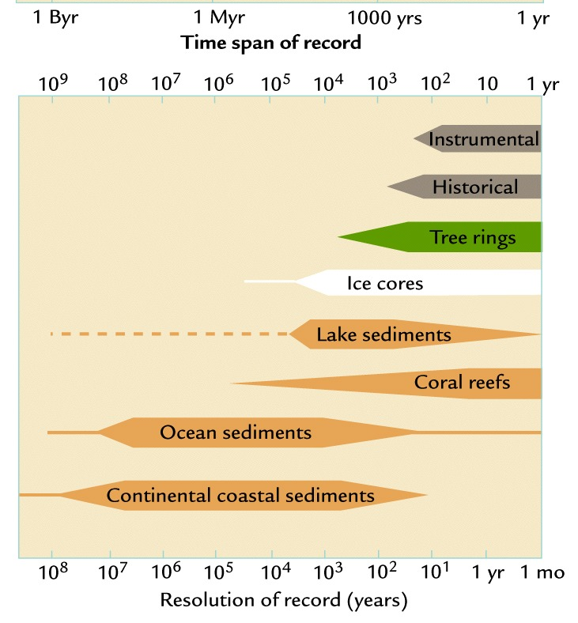
Proxy Records of Climate
Uses of proxy records of climate depend on both
- time span of record
- resolution of record

Slide 14
Proxy Records of Climate
Proxies that record annual growth patterns can indicate year to year variations in climate
-tree rings
-ice cores
-deep lake sediments
-coral reefs
Limited to last 500-1000 years except ice cores
Notes:
Each has differnet uses and limitations

Slide 15
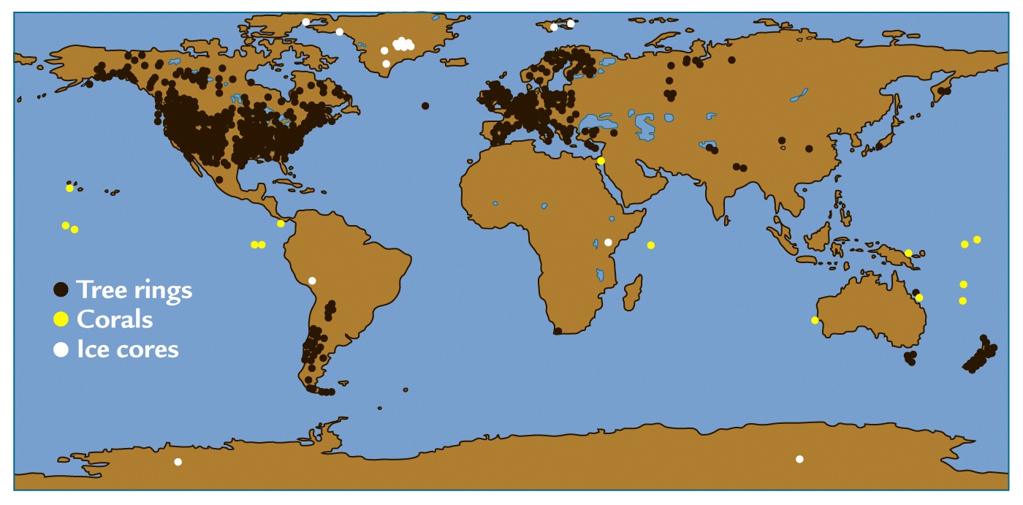
Tree Rings
Lighter, thicker wood tissue formed by rapid growth in spring and much thinner, darker layers marking cessation of growth in autumn and winter
Limited to land areas outside of tropics
Variations of tree ring width and density act a recorders of year to year changes in temperature and rainfall

Slide 16
Varved Lake Sediments
Complement tree ring records
Occur in deeper parts of lakes that do not support bottom-dwelling organisms that would obliterate annual layers with their activity
Layers usually result from seasonal alternation between light, mineral-rich debris and dark, organic rich material brought in by runoff – act as proxy of precipitation amount

Slide 17
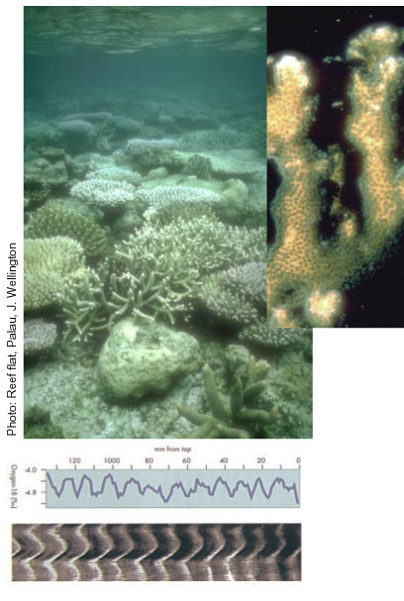
Corals
Texture of calcite (CaCO₃) incorporated in skeletons varies lighter parts during periods of rapid growth in summer and darker layers during winter
Measurements of oxygen-18 isotope concentration records sea surface temperature and salinity (precipitation and runoff) variations
Limited to tropical oceans

Slide 18
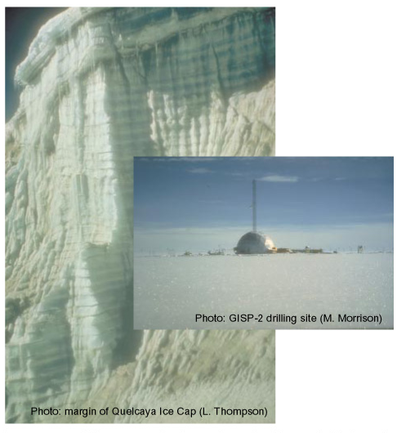
Ice Cores
Limited to polar latitudes and mountain glaciers
Darker and lighter layers are more or less dust blown in seasonally
Measurements provide information on temperature, snowfall, atmospheric composition (gases, dust, volcanic aerosols), sunspots, …
Notes:
Extend back about 440,000 years

Slide 19
Proxy Records of Climate
Proxies for more ancient climates are found in sediments or inferred from fossils and land forms
Can generally only resolve changes that occur over 50 years or greater
Notes:
Limted to usually last 500-1000 years except for ice cores

Slide 20
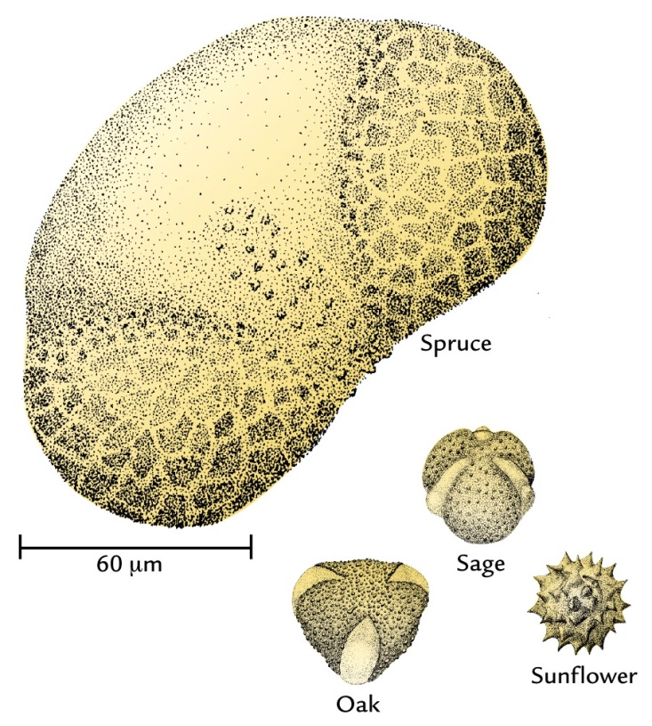
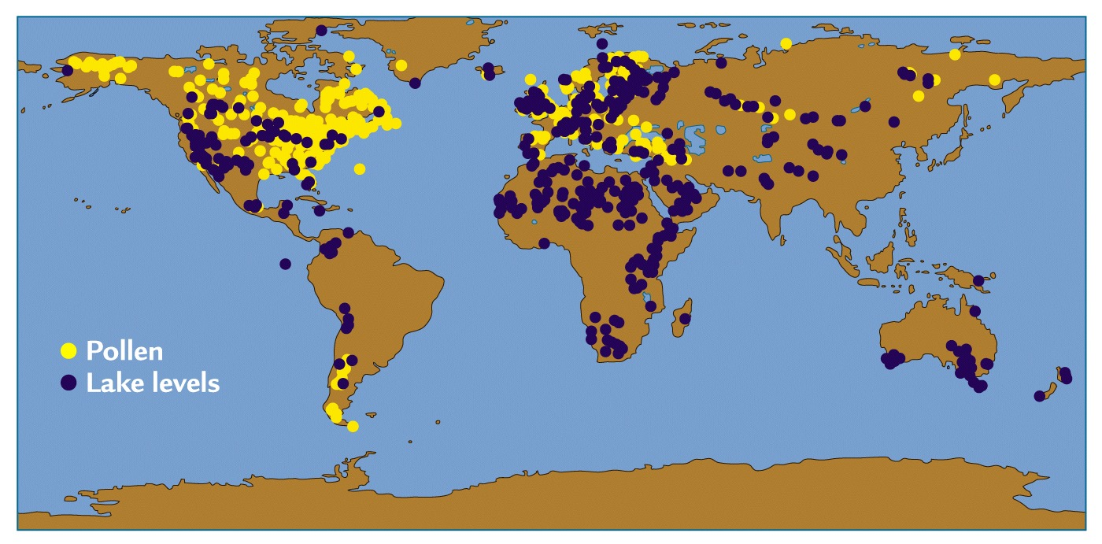
Pollen
Deposited in lake and ocean sediments and in ice cores
Changes in relative abundances of distinctive types of pollen allow inference on vegetation occurring in a region and thus climate
Limited to past several million years when modern vegetation still present
Notes:
Spruce today is mainly found in cold climates of NE Canda; during glacial periods has been found as far south as penn and Ohio

Slide 21
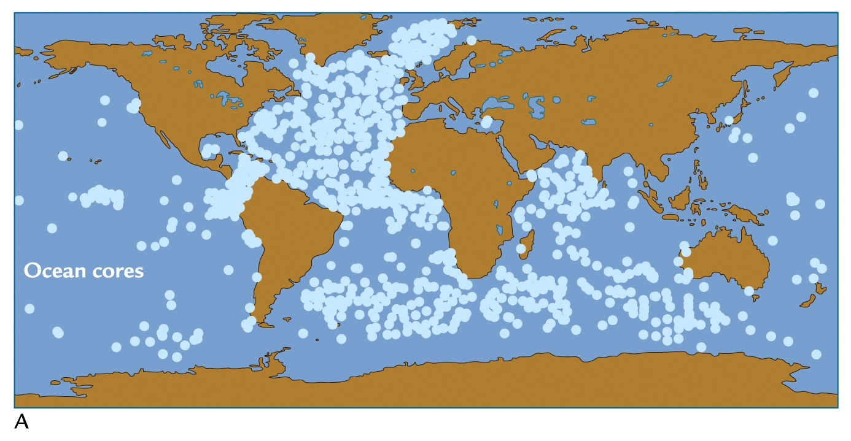
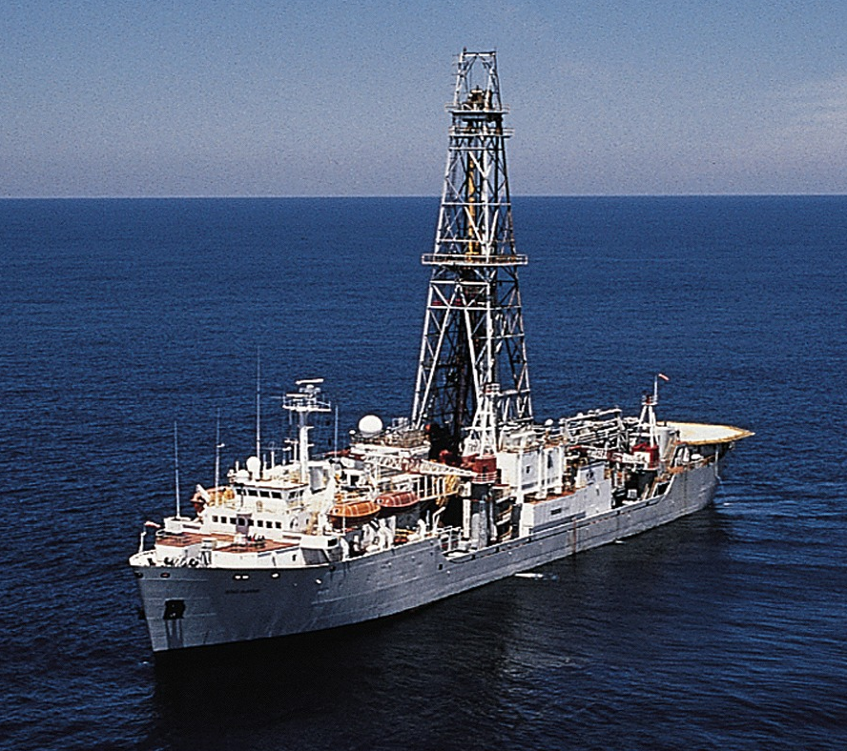
Marine Sediments
Long cores drilled by specially equipped ships
Dating only accurate to about 40,000 years ago and can resolve climate changes that occur on century scale or longer

Slide 22
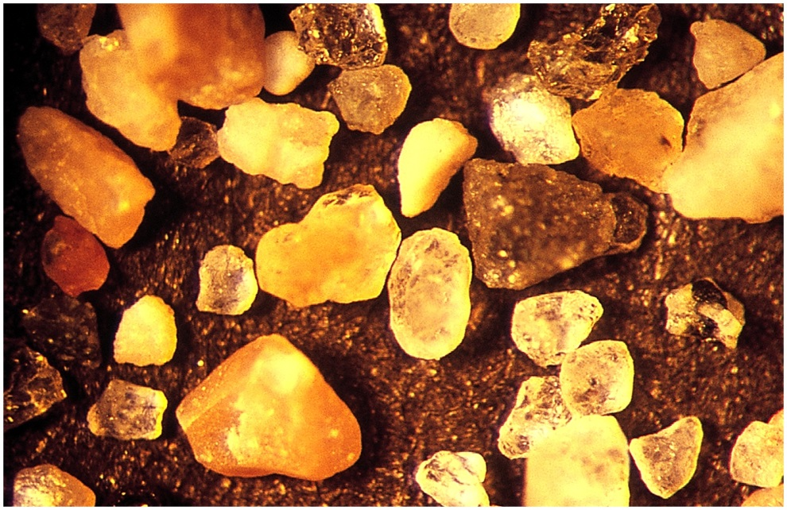
Marine Sediments
Isotopes in shells of microfossils can reveal temperature, salinity, and ice volume
Granular debris from land can indicate icebergs breaking off of continental ice sheets

Slide 23
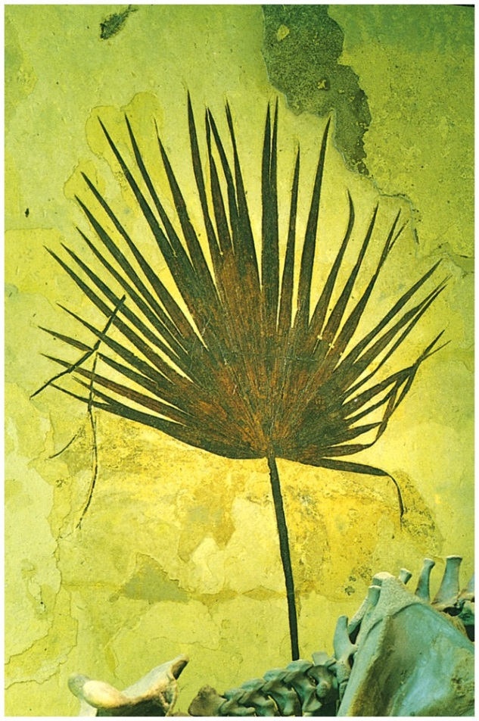
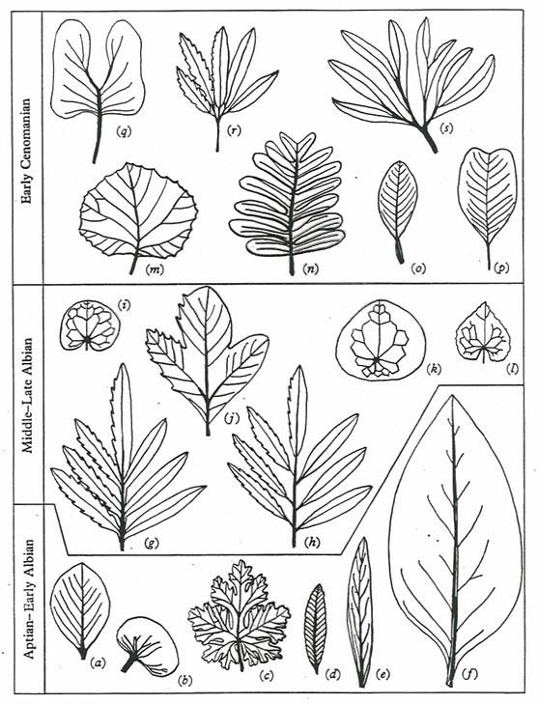
Fossils and Landforms
Climate can be inferred from distinctive vegetation type
Climate can be inferred from leaf size and shape

Slide 24
Fossils and Landforms
Climate can be inferred from distinctive land forms
Climate can be inferred from leaf size and shape

Slide 25
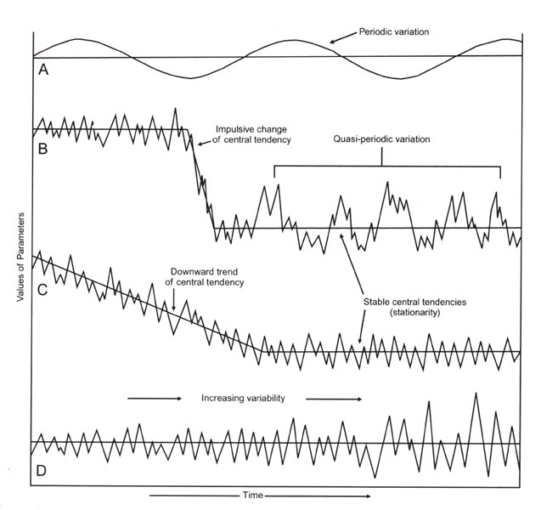
Climate Variation and Variability
Proxy data and climate models (CSM) together can be used to understand how and why climate changed in past
Three examples that are relevant to future
Changes in amplitude or frequency of climate oscillations
Notes:
Will show proxydata and model results

Slide 26
Climate Variation and Variability
ENSO over the last 11,000 years
Notes:
Will show proxydata and model results

Slide 27
Sources
E. Aguado.Weather & Climate. 2001. pgs 435-445
www.ucar.edu/educ_outreach/gew/.../paleoclimates_073002.ppt

