Slide 1
Welcome Back Kidlets!
Please:
Pick up the sheets from the front table
Sit where there is a white sheet of paper (I’ll be rearranging you after our first activity)
Read the half sheet on the table and work individually on this as I take attendance

Slide 2
Chat With Your Group: 2 minutes
What steps are involved in making scientific discoveries?

Slide 3
Mystery Boxes – Background/Expectations
I DO NOT HAVE A CLUE WHAT IS INSIDE
BUILT BY MR. HOLZGRAFE 20 YEARS AGO
They are on loan from my mentor teacher who works with college students at UT
I appreciate that you are respecting her property by handling the boxes with care
These boxes are still a mystery to her and she would appreciate it if I returned them to her as they are…UNOPENED ☺

Slide 4
Mystery Boxes – Flying Solo
Examine the mystery box
On the back of your half sheet,
Write down as many questions that you have about the box at your table/at other tables

Slide 5
Mystery Boxes: Table Talk
Discuss your questions as a group
Use the chalk to write on the table for steps 3 and 4
Write down 3 assumptions you have about the mystery box and/or what is or is not inside of it
Make at least 10 observations. They must be written as follows: I see, hear, smell, feel
Probably a bad idea to taste the box ☺

Slide 6
Mystery Boxes
How could we make more accurate observations?
What tools could we use to determine what is inside the box?
How are the mystery boxes related to what scientists do?

Slide 8
What do you see?
What’s happening in this picture?
What do you see that makes you say that?
What more can you find?

Slide 9
Hurricane Storm Tracks
2014 Hurricane Season

Slide 10
Hurricanes
Each group will plot data for one storm from the 2014 season
Answer all questions on the back of your hurricane tracker
Short answer is OK ☺

Slide 11
Hurricane Plotting Hints
Note the dates of the storm that you have been assigned. List it under #6. Make sure you leave room for the other storms
Only plot points that correspond to those dates
There are multiple plots for the same date, what do you notice about their locations in terms of longitude and latitude?
If points are too close, only plot one point for that date ESPECIALLY if there was a change in the stage of the storm
If points are “off the map” then don’t plot them ☺

Slide 12
Saffir-Simpson Scale
Category | Wind Speed (mph) | Wind Speed (km/hr) | Wind Speed (kt) | Storm Surge (ft.) | Stage
TD | Less than 39 | Less than 62 | Less than 33 | - | Tropical Depression
TS | 39-73 | 63-118 | 34-63 | - | Tropical Storm
1 | 74-95 | 119-153 | 64-82 | 3-5 | Hurricane
2 | 96-110 | 154-177 | 83-95 | 6-8 | Hurricane
3 | 111-130 | 178-209 | 96-112 | 9-12 | Hurricane
4 | 131-155 | 210-249 | 113-136 | 13-18 | Hurricane
5 | More than 155 | More than 249 | More than 137 | More than 18 | Hurricane

Slide 13
WELCOME TO MS. TASNEEM’S CLASS!
8TH GRADE MAGNET EARTH SCIENCE
7th & 8th Grade Marine Biology

Slide 14
How does the item represent me?
Text this number 443781 and your response (your appropriate response!)
To this number 37607
Who do you send the message to?
Which number has to be associated with your message?

Slide 15
Ms. Tasneem Facts:
A Pakistani
An only child
A risk taker
A native El Pasoan
A UT Graduate…Hook ‘em horns!
A traveler
Marley and Austin’s mama
A terrible speller
Sarcastic and funny so laugh at her jokes and don’t get offended!!!
A teacher who is obsessed with making brightly colored signs ☺

Slide 16
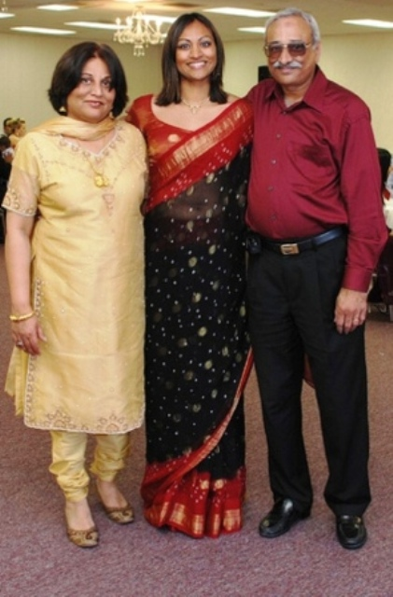

Slide 17
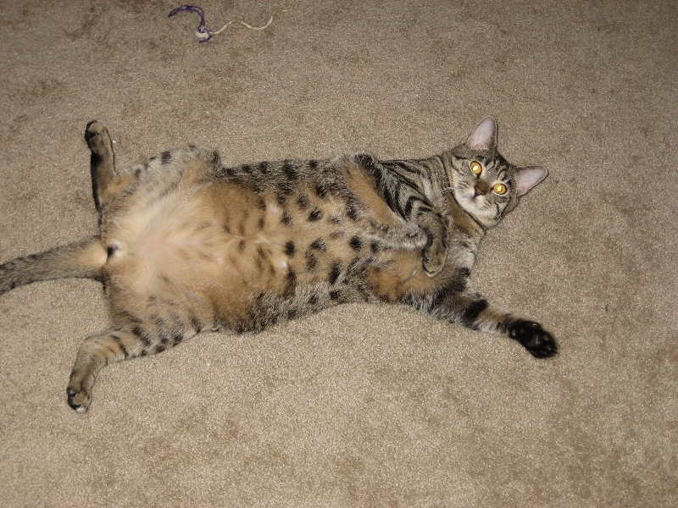
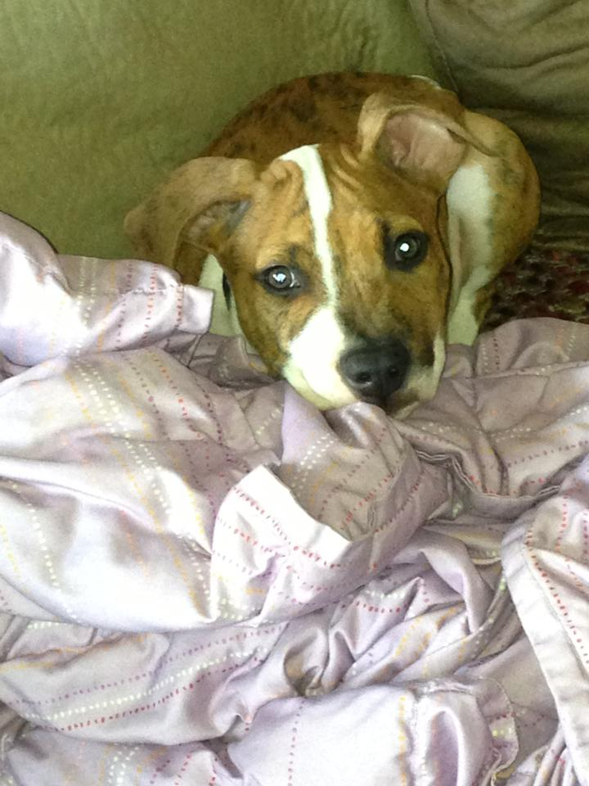
These are my Babies…

Slide 18
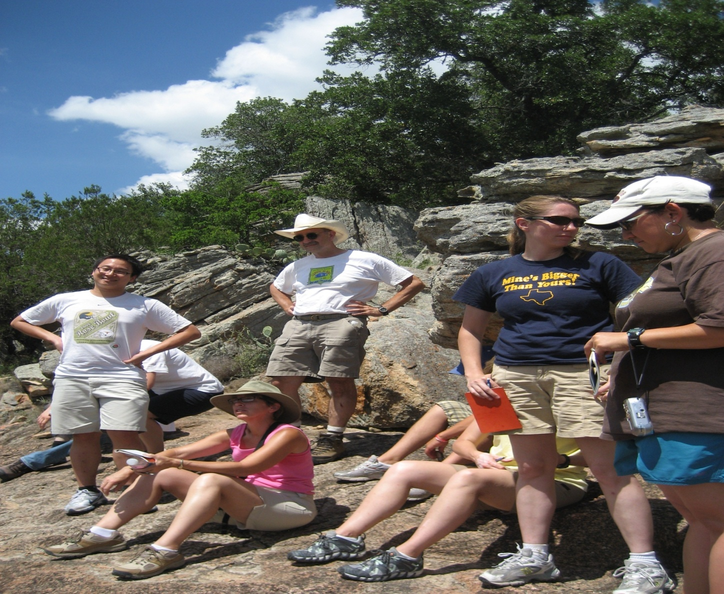
Here she is on her travels…

Slide 19
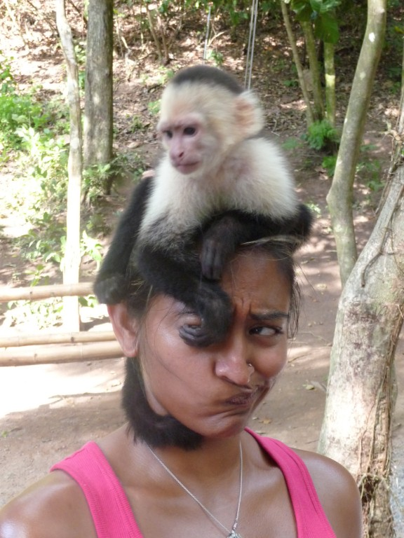
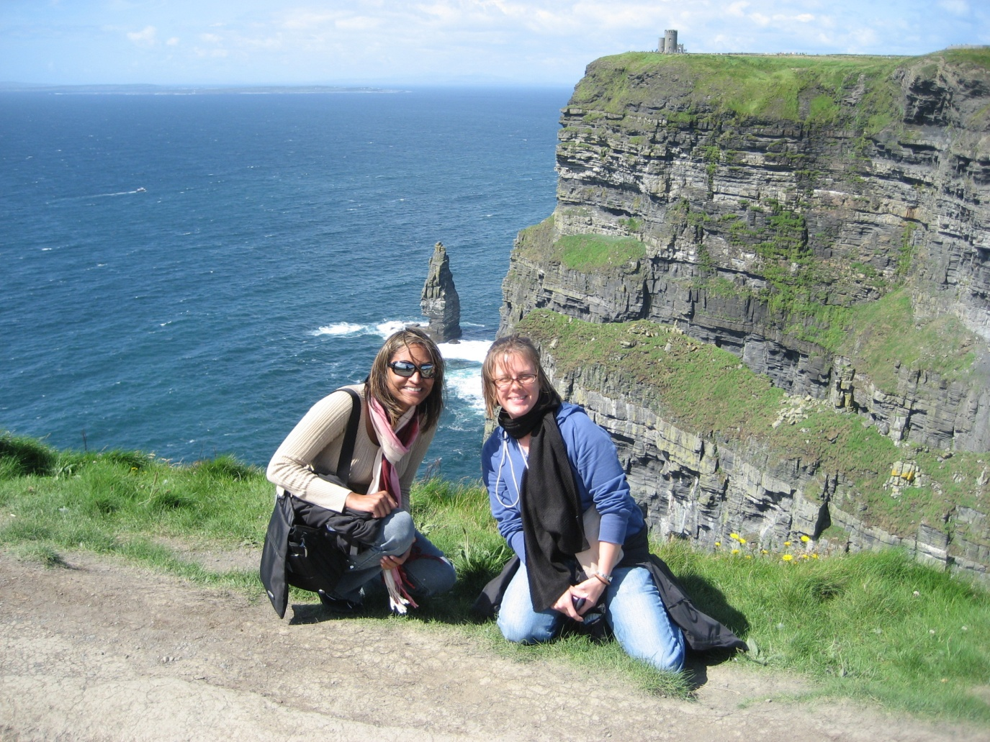
Here she is on her travels…
Honduras
Ireland

Slide 20
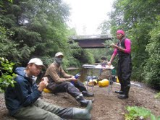
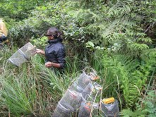
This summer…

Slide 21
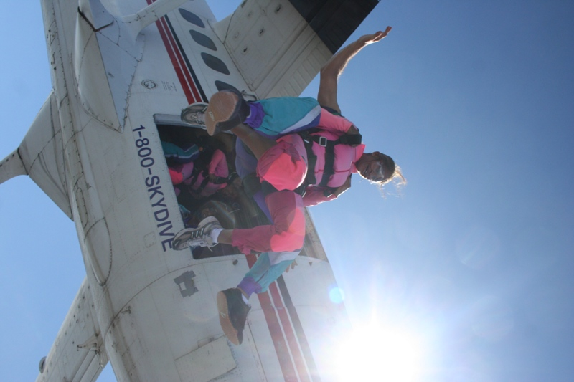
Risky Business…

Slide 22
Ms. Tasneem’s Expectations
WORK HARD
PLAY HARD
& ALWAYS
KNOW WHAT
TIME IT IS

Slide 23
BE PROMPT
Follow Directions Quickly
Don’t waste class time
Be quick about getting out your books, paper, and pencils or doing something that I have asked you to do

Slide 24
BE PREPARED
Come to class on time
Read agenda, pick up papers, turn in hw BEFORE the bell rings
Designated student(s) will be chosen at random to help pass back graded work
Take responsibility for your own actions

Slide 25
BE PRODUCTIVE
Make smart choices.
Complete all your work on time by mono-tasking.
Don’t waste class time.
Work together to get labs finished.
Always contribute to your group.

Slide 26
BE POLITE
Respect EVERYONE
Don’t borrow things without asking
Don’t talk about other students or teachers negatively
Take responsibility for your own actions
Be nice and helpful to your fellow students
Actively listen to others’ opinions and work together to come to a solution

Slide 27
Keep Ms. Tasneem ☺
I am ☺ when all my students are having fun learning science!
I am ☹ when someone
makes it difficult for other students to learn!

Slide 28
It’s Time
for a
Scavenger Hunt
Can you find all the information you need to survive 8th grade science?

Slide 29
DIRECTIONS
Use your:
Welcome letter
Daily routines sheet
Safety contract
Signs around the room
To help you complete the assigned questions on your worksheet
#20 will be done at home WITH your parent/guardian

Slide 30
3. What are the class rules?
1. Where can you find the answer to some students’ favorite question: “What are we doing today?”
Look at the AGENDA on the whiteboard or read the OVERHEAD SCREEN.
2. Where do you pick up papers for class or homework?
On the front table with the Voice level signs.
3. What are the class rules?
#1 Be Prompt
#2 Be Prepared
#3 Be Productive
#4 Be Polite
#5 Keep Ms. Tasneem ☺

Slide 31
4. What is Ms. Tasneem’s e-mail address? List at least 3 places where you can find this information.
Tania.tasneem@austinisd.org
#1 (in the classroom) on the wall
#2 welcome letter
#3 kealinghornets.org
5. What supplies do you need for this class?
A 2-INCH binder, pen (any color except PINK), at least 8 COLORED PENCILS

Slide 32
6. Where can you find the following class supplies?
Pencil Sharpener – on the bookshelf by the windows
Box of Kleenex- by the hole puncher
Emergency Map- by the front door
Dictionaries or Science Books- bookshelf (window)
Scissors, Glue, Rulers,colored pencils, markers
Staplers, hole-puncher: student supplies station at front of the room
Printer Paper- Ms. Tasneem’s computer cart
Colored Printer Paper- Ms. Tasneem’s computer cart
What is the borrow box? How does this system work?
Student: Can I borrow a pen/pencil?
Ms. Tasneem: Absolutely! If I can borrow something of yours (shoe, cell phone, ipod, etc.) while you borrow something of mine

Slide 33
8. How are grades calculated in this class?
Labs 40%
Tests 30%
Hw starters/classwork 20%
Quizzlets 10%
9. What happens if I catch someone cheating?
All students involved will earn ZERO points for that assignment.
10. How many days do you have to turn in late work? What is the maximum number of points that you will earn if you turn in work late? Where do you turn in late work?
3 Days
50 percentage points
In the LATE WORK bin by the window

Slide 34
In Ms. Tasneem’s 5.5 years of teaching experience, she has really come to strongly dislike when students ask/tell her: “I was absent, what did we do?” Because there are 3 systems in place help you catch up when you were out ☺
#1 Buddy memos. Where are the buddy memos located? on the Whiteboard under the agenda Who fills out a buddy memo for you if you are absent? ONE OF YOUR GROUP MEMBERS
#2 What did we do? Board. How do you utilize this system?
a. Look at the WHAT’S DUE log to the left.
b. Find the papers you need (match the numbers)
c. If you can’t find the papers you need, ask me AT THE END of class.
d. If you missed a LAB you have 1 week to come to TUTORING and make it up.
#3 What is the URL for Ms. Tasneem’s website? Ttasneem.yolasite.com

Slide 35
12. How long do you have to turn in make up work? Where do you turn in make up work (specifically where is this located in the room)?
1 WEEK
In the MAKE UP WORK bin by the window
13. What are the extra credit opportunities each six weeks? How is extra credit awarded?
ATTEND OUTREACH LECTURE OR CONTRIBUTE TO WONDER WALL
EXTRA CREDIT = FREE 100 ON HW/CW OR QUIZ GRADE

Slide 36
14. How does the wonder wall work?
I can ASK a question or ANSWER a question RELATED to any topic we are discussing. After my QUESTION or ANSWER are approved by Ms. Tasneem, I can staple it to the wonder wall for extra credit. I can ask as many questions as I want, but will only be awarded extra credit ONCE per six weeks.
15. What projects will we be doing this year?
The first one happens in the FALL semester and will be during the CLIMATE unit. The second one happens in the SPRING semester and will be during the PALEOGEOGRAPHY UNIT.
16. Where is the fire extinguisher?
Under the TEXAS Flag

Slide 37
17. What do you do when you are tardy?
Sign the TARDY LOG located on the CART by the door. After 3rd tardy you will receive an administrative referral.
Students: “Can I go to the Bathroom?”
Ms. Tasneem: “I don’t know can you?”
ASK for my permission BEFORE you leave. Take the BLUE pass located on the CART by the door. You many not go the first or last 5 minutes of class.

Slide 38
20. Chat with your parents! Your parent/guardians are to fill out the rest of the table!
Student Instructions | For Parents/Guardians ONLY | Parent/Guardian Comments
Show your parents how to get to my website | Is the site easy for you to navigate?
Navigate to the parent FAQ section. | Do you have any other questions/concerns that are not addressed in the FAQ? If so, please share in the box to the right.
Navigate to the student FAQ section and read this with your parents along with the answers to questions #1-18 | Do you and your student have any other questions concerning the syllabus, routines, or procedures in this class? If so, please share in the box to the right.
What is due next class? Some require parent/guardian signatures!!! | Parents, please list what forms require signatures in the box to the right and are expected to be turned in next class.

Slide 39
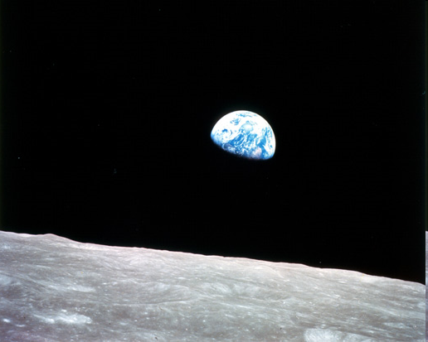
19. Why Earth Science?
Source of photo: www.nasa.gov

Slide 40
Why should I care?
We live on earth!
Earth science empowers us to think globally and act locally
Earth science creates informed citizens
Earth science poses exciting questions
Earth Science builds careers for life
(Big $$$$)
Adapted from: www.geosociety.org/graphics/eo/Why_Earth_Science.pdf

