Slide 1
Clearing up the Coriolis Effect
* = Spinner of the globe
1
Draw a straight line from the North Pole to the Equator. This will be our reference line
2
Attempt to draw a straight line from the North Pole to the Equator as the spinner gently spins the globe
3= Southern hemisphere
Groups of 3 = combine #2 and #3

Slide 2
Coriolis Effect
What is it?
How does it affect large scale systems on Earth?
How is it related to hurricanes?
Which direction are paths deflected in the northern hemisphere?
Which direction are paths deflected in the southern hemisphere?

Slide 3
How does coriolis effect affect hurricanes?

Slide 4
U.S. vs. Australia
“Hurricane” Dean
“Cyclone” Monica

Slide 5
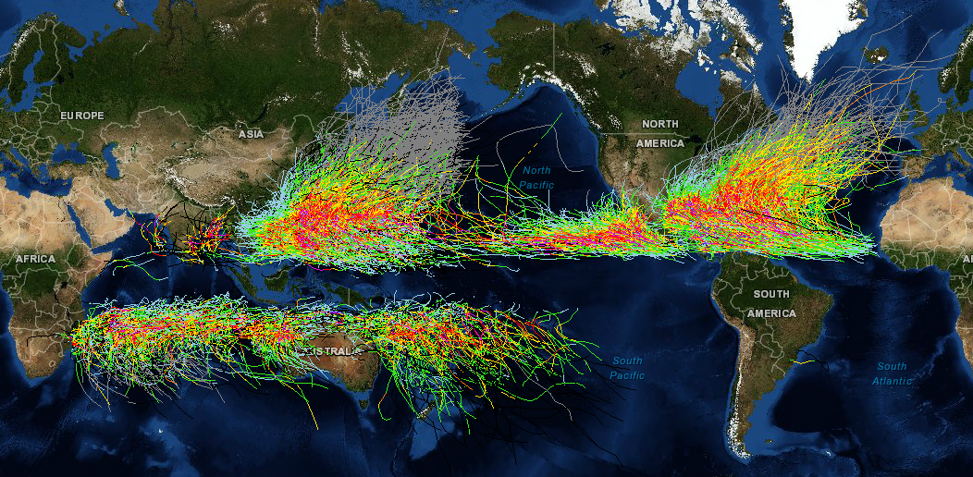
Hurricane Tracks 1985_2005

Slide 6
Hurricane Origin & Lifecycle

Slide 7
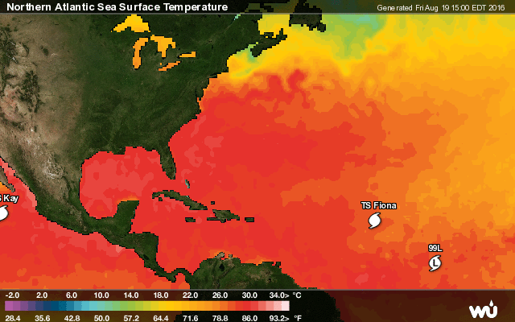

Slide 8
Saffir-Simpson Scale
Category | Wind Speed (mph) | Wind Speed (km/hr) | Wind Speed (kt) | Storm Surge (ft.) | Stage
TD | Less than 39 | Less than 62 | Less than 33 | - | Tropical Depression
TS | 39-73 | 63-118 | 34-63 | - | Tropical Storm
1 | 74-95 | 119-153 | 64-82 | 3-5 | Hurricane
2 | 96-110 | 154-177 | 83-95 | 6-8 | Hurricane
3 | 111-130 | 178-209 | 96-112 | 9-12 | Hurricane
4 | 131-155 | 210-249 | 113-136 | 13-18 | Hurricane
5 | More than 155 | More than 249 | More than 137 | More than 18 | Hurricane

Slide 9
What do you see?
NASA visualization

Slide 10
It’s worth sketching the parts…

