Slide 1
KTX: Trivia
Part 1: Tuesday, October 1st
Part 2: Monday, October 7th
Part 3: Tuesday, October 8th
Notes:
This week we will learn about people and places in and around Kealing Middle School. Today I’m going to give you a little bit of background on some historic sites, places and people in the Kealing community. Listen closely because next week we will create ‘billboards’ to educate Kealing faculty and students about Kealing’s neighborhood. Feel free to have the students read out loud an excerpt below for each of the corresponding powerpoint slides. The pages are copied to allow for cutting out each topic.

Slide 2
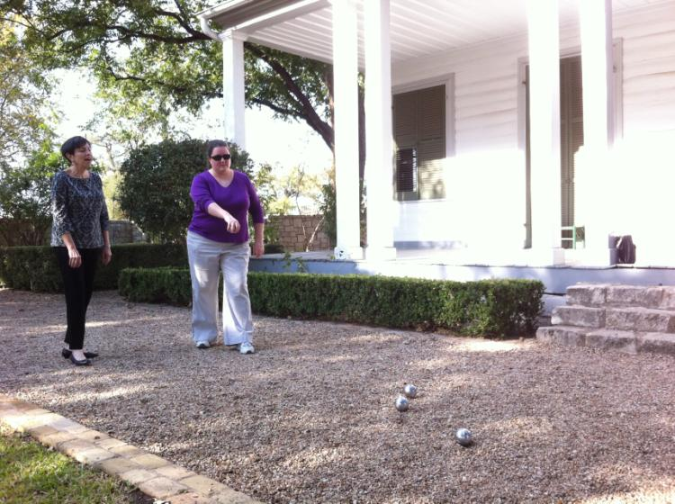
French Legation
Notes:
The French Legation-8th and San Marcus
The French Legation Museum began in 1841 as a private home built for the French charge d’affaires, Alphone Dubois. Currently, it serves as a museum to promote the understanding and appreciation of Texas history.

Slide 3
Texas State Cemetery
Notes:
Texas State Cemetery-11th and Navasota
The Texas State Cemetery is the final resting place of Governors, Senators, Legislators, Congressman, Judges and other legendary Texans who made the state what it is today. Stephen F. Austin, University of Texas football coach Darrell Royal, Governor Ann Richards and U.S. Congresswoman Barbara Jordan are all buried here. Several changes have been made to the site such as an extensive renovation project completed in 1997.

Slide 4
Detrich-Hamilton House
Notes:
Detrich-Hamilton House- 912 11th Street
This is the first house in Austin bought by freed slaves

Slide 5
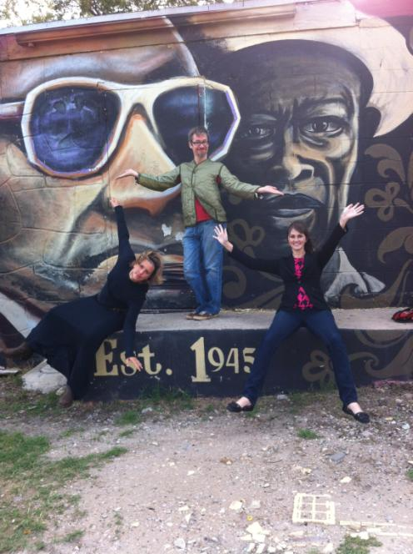
Victory Grill
Notes:
Victory Grill-11th and Waller
Victory Grill is a historical music venue that has hosted famous African American acts such as Bobby Bland, Clarence “Gatemouth” Brown, W.C. Clark and B.B. King when Austin was legally segregated.

Slide 6
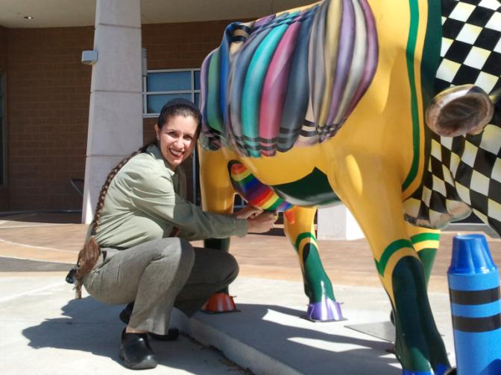
Carver Museum
Notes:
Carver Museum (original building) 1165 Angelina Street
The building which is now the Carver Museum was the original Carver Branch Library downtown. When a new library was built downtown in 1933 to replace the much smaller one, the smaller wooden frame building was moved to Angelina Street-here on the east side. It became the first Austin Public Library branch to serve black citizens. East Austin’s black citizens advocated strongly for a library in their community.

Slide 7
East Side Pies
Notes:
East Side Pies- 1401 Rosewood
Michael Fried and Noah Polk opened this little place about seven years ago to bring New England style pizza to central Texas. It’s won many a pizza award each year since it’s opened.

Slide 8
Franklin BBQ
Notes:
Franklin’s BBQ-900 East 11th
Before it was Franklin’s BBQ, it was Ben’s BBQ and before Franklin’s BBQ moved to the brick and mortar building on 900 East 11th Street, Aaron Franklin sold his BBQ from an east side parking lot. But now this little place is straight up famous, earning several national food awards. People line up for hours before the doors open just to taste brisket, sausages, and ribs. They are often sold out of their famous brisket by noon.

Slide 9
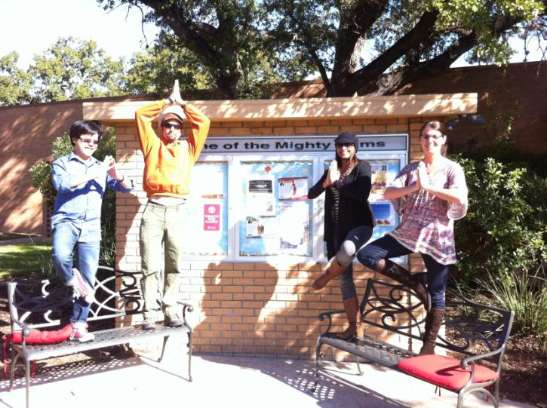
Huston-Tillotson
Notes:
Huston-Tillotson University
Huston-Tillotson is a historically black university in Austin, Texas. The school is affiliated with the United Methodist Church, the United Church of Christ, and the United Negro College Fund. Huston–Tillotson University awards four-year degrees in business, education, the humanities, natural sciences, social sciences, science and technology. The University also offers alternative teacher certification and academic programs for undergraduates interested in pursuing post-graduate degrees in Law and Medicine.

Slide 10
Farmer “Freedom Rider” House
Notes:
Farmer Freedom Rider House
Civil Rights leader James Leonard Farmer, Jr. lived in this house a child from 1925-1930. His father taught at Samuel Huston College, now Huston-Tillotson University. James Jr. founded the Congress of Racial Equality (CORE) in 1942 which trained civil rights leaders Ghandi-inspired nonviolent civil disobedience tactics to protest racial discrimination. Under Famer’s leadership, CORE organized the 1962 ‘freedom riders’ to desegregate interstate transportation in the deep south. He later became an assistance secretary in the U.S. Department of Health, Education and Welfare. He received a presidential medal of freedom in 1998.

Slide 11
Howson Community Center
Notes:
Howson Community Center-1192 Angelina
The Howson Community Center was established in 1929 to serve as a meeting place for residents in East Austin. The African American community wanted a place where citizens could gather to engage in social, educational and community wellness activities. Organizations like Girl Scouts, Federation of Women’s Clubs and Negro Citizens Council as well as art classes and well-baby clinics have all met in this historic building currently undergoing renovations.

Slide 12
“Rhapsody” Mural
Notes:
“Rhapsody” Mural-
Seventy years ago, East 11th street was Austin’s mecca for jazz. And in honoring that spirit, John Yancey, associate chairman of the Department of Art and Art History in the College of Fine Arts, has designed a piece of public art that both celebrates history and preserves the cultural heritage of an area undergoing rapid change. His 50-foot-long mural pays homage to longstanding African American institutions and community buildings. It is peopled by elders and youth alike. Bright suns and the patterns of a quilt hold it together. And it culminates in a jazz quartet caught mid-song, honoring the earliest music scene in town.
-Vive Griffith at University of Texas at Austin

Slide 13
Kealing Middle School
Notes:
Kealing Middle School
Kealing Middle School was first opened in 1930 as the first African American junior high school in Austin (originally known as Anderson High School). It was named for African American educator, writer, editor and activist Hightower Theodore Kealing. The school was closed in 1971 due to desegregation efforts. The Anderson campus was burnt down by a fire, but the school reopened 1986 under the name Kealing Junior High School. In 2004, Kealing expanded to include sixth grade students and converted to a middle school. Our colors are crimson and cream and our mascot is a hornet

Slide 14
Maria Martinez: Clerk
Notes:
Maria Martinez-Officially the magnet clerk but she can do anything!
Maria came to the United States in 1985 from Guadalajara, Mexico. She earned her GED in 1996 and began working in Austin schools that same year. She loves travelling, spending time with her kids and cats!

Slide 15
Kendra Wheeler: Administrative Assistant
Notes:
Kendra Wheeler-Administrative Assistant to Mrs. Lowe
Kendra has been at Kealing for two years now and she is amazing. She speaks Spanish, is very creative and supports her son in his baseball and basketball events. Her favorite thing about Kealing is watching the students change from year to year.

Slide 16
Mary Ramberg: Interim Magnet Director
Notes:
Ms. Ramberg worked at Kealing for 5 years, retired for two years and then returned for a sixth to serve as our interim director. She loves the teachers. In her free time, she reads-a lot- and spends time with her grandchildren. All of the places she has lived have been capital cities, Austin, Texas, Madison, WI, Jackson, MS and Washington, D.C.

Slide 17
LaNica Failey: former Kealing student & STAR Director
Notes:
LaNica Failey-Academy Director
Before becoming Kealing’s Academy director, Ms. Failey was a hornet, attending Kealing Middle School as a magnet student not so long ago. She returned to Kealing as a math teacher and then became assistant principal in Manor ISD. She must have really missed us because she once again came ‘home’ as the Kealing Academy director and has served families and students in that position for the past three years.

Slide 18
Robin Lowe: Principal
Notes:
Robin Lowe-Principal
Mrs. Lowe has been our fearless leader for the past two years. The loves the diversity at Kealing. She is an avid reader and really likes heights. You might find Ms. Lowe taking the Leap of Faith jump at a theme park or walking on glass floors 100 stories in the air or zip lining when she isn’t inspiring teachers and students at Kealing.

Slide 19
Billboards
Next week, each student will create a ‘billboard’ to educate students, faculty and visitors about Kealing Middle School and the community in which Kealing resides.
You will choose one topic from the previous slides. Each advisory should cover ALL the topics.
Your billboard should be/have:
Bold
Neat
Title
Short description of site/person
Educational
Notes:
Billboards-activity Monday, October 7th and October 8th-more information will come!

