Slide 1



Missing alien
Modified from John Bergmann and Jeff Christopherson

Slide 2
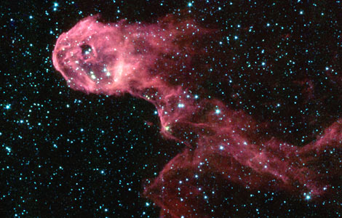






Aliens
Introduction to
Periodicity

Slide 3
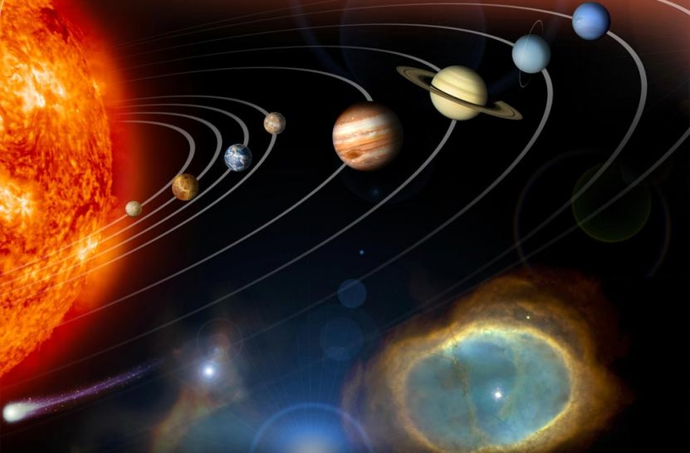

Your Mission
NASA has recently found life on a nearby planet!
These aliens have many similarities and differences and NASA is in need of a way to organize these life forms.
Your job is to create a table to arrange these new life forms.

Slide 4
Getting Started
NASA’s instructions:
  Organize the aliens in a rectangular block.
  Each group (vertical column) must be the same in some way (3) and must have some feature (2) that changes regularly as you move down the group.
  Each period (horizontal row) must also share one thing in common and also must have at least one feature (4) that changes regularly as you go across the periodic table.
g
r
o
u
p
period

Slide 5


The One that Escaped
One of the aliens found escaped in the transportation process.
NASA would like you to make detailed drawingsof what you believe those aliens looked like.
They would also like you to describe the two missing aliens.

Slide 6

The Aliens We Didn’t Find
Describe what the next alien would look like in your periodic table.
Also include a drawing of this alien.
1 2 3 4 5 6 7 8
X
Period __ & Group __
1
2
3
4
5
Y
Period __ & Group __

Slide 7
Missing Alien Discussion
Groups (families):
What characteristics do they share?
  # of hairs
  Body pattern
  Facial expression
How are these characteristics related to the bohr models?

Slide 8
Groups/Families
Relationship of Alien Characteristics to Bohr Models:
  # of hairs = valence electrons
  Body pattern = similar chemical reactivity
  Facial expression = similar probable charge

Slide 9
Valence Electron Notes
Electrons surround nucleus at different energy levels, orbitals, or shells
Energy increases as you move away from the nucleus
Follow 2, 8, 8 for the first 18 elements

Slide 10
Valence Electron Notes
Highest energy electrons are involved in bonding and occupy the valence shell
These electrons are called valence electrons
# of valence electrons determines stability and probable charge to acquire stability
Noble (inert) gases are stable with 8 valence electrons
Desire to have 8 valence electrons = octet rule

Slide 11
Exception to the Octet Rule
How many valence electrons does Helium have?
How many energy levels does helium have?
What is the maximum number of electrons that can be found in the first energy level?
Is helium stable with the number of valence electrons it has?

Slide 12
Valence Electron Notes
Desire to acquire 8 valence electrons also determines patterns found in typical charge or oxidation #
All aliens have same # of hairs in one group
All elements have same # of valence electrons in one group

Slide 13
Valence Electron Notes
Metals:
  Tend to lose their valence electrons
  Giving them an overall positive charge
  We call these ions cations
Nonmetals:
  Tend to gain valence electrons
  Giving them an overall negative charge
  We call these ions anions

Slide 14
Missing Alien Discussion
How does the size of the aliens change as you go across a period? What about the groups?
Size = atomic radius
More shells = fatter radius
Across the rows = protons keep electrons close

Slide 15
Missing Alien Discussion
How many arms do the aliens have in the first row? 2nd row? 3rd row?
How are the row numbers and the number of energy levels related in the bohr models?

Slide 16
Valence Electron Notes
Alien dots = # of electrons
Valence electrons like to occupy their shell in pairs
We use Lewis Dot Structures to represent them

Slide 17
Valence Electron Notes
Drawing Lewis Dot Diagrams:
1. Find # of valence electrons using group number
2. Start placing dots one at a time around the chemical symbol
3. If you have more than four, start to pair dots until you’ve used them all

Slide 18
Valence Electron Notes
Lewis Dot Structures show paired and unpaired electrons
These unpaired electrons are important for bonding and chemical reactions

