Slide 1
Ocean Zones
Introduction

Slide 2
Classifying Marine Organisms
Based on Lifestyle:
Benthic – bottom dwellers
Pelagic- in the water column
How well they swim:
Plankton- drifters/floaters
Nekton- can swim against the current (not all nekton are pelagic)
Example: Ray

Slide 3
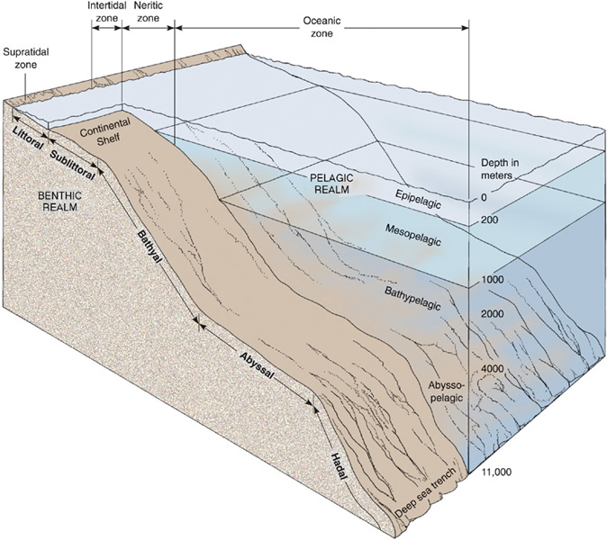
Based on
the diagram,
what are the major and minor subdivisions of marine environments based on?

Slide 4
Grouping Activity
In your envelopes, there are 18 facts about different zones of the ocean
Please make sure you have 18 strips of paper and DO NOT LOSE THEM!
Group these facts however you choose (there does not necessarily have to be equal facts for each group you make)
Be ready to justify how you decided on these groups
Write your groups on the back of your video questions

Slide 5
Euphotic Zone
This is the top layer of the ocean
Photosynthesis can occur here
More than 90% of marine animals live in this zone
This zone is known as the “Sunlight zone”
This zone extends from the water’s surface down to about 50 meters
The name of this zone means “well lit” in Greek
Food is abundant here
You might find sharks, tuna, mackerels, jellyfish, sea turtles, or stingrays here

Slide 6
Dysphotic Zone
The name of this zone means “poorly lit”
This zone is known as the “Twilight Zone”
This zone extends from about 50-1000 meters
There is some light here but not enough for photosynthesis, thus there are no plants

Slide 7
Aphotic Zone
No sunlight reaches this layer of the ocean
This zone makes up 90% of the ocean
Water pressure is extreme here, sometimes up to 2 tons per square inch
Temperatures are close to freezing in this zone
This zone is also known as the “Midnight Zone”
The deep sea anglerfish is one of many species in this layer that have their own light-producing organ to attract prey or a mate

Slide 8
Major Subdivisions of Marine Environment
Based on
Benthic or pelagic organisms
Distance from land
Water depth

Slide 9
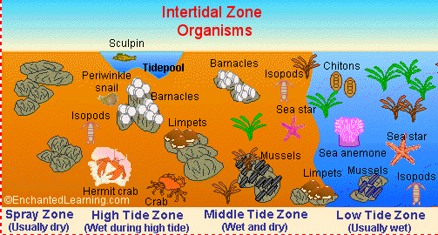
Intertidal zone (littoral)

Slide 10
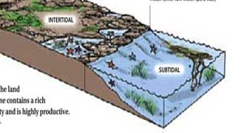
Subtidal zone (sublittoral)

Slide 11
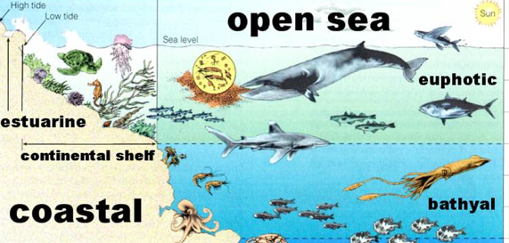
Bathyal zone

Slide 12
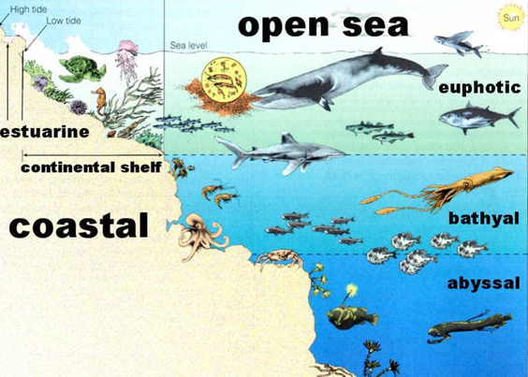
Abyssal zone

Slide 13
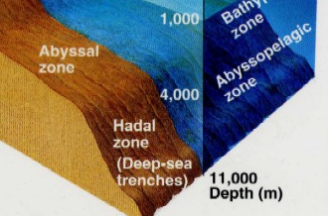
Hadal zone

Slide 14
“Deep Sea Floor”
Bathyl
Abyssal
Hadal

Slide 15
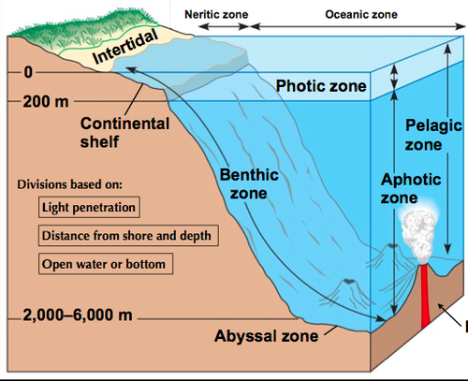
Pelagic
Notes:
http://www.google.com/search?q=pelagic+zone&safe=active&client=firefox-a&hs=jFr&rls=org.mozilla:en-US:official&source=lnms&tbm=isch&sa=X&ei=IrdBUsuMCoXM9gSKjIGYCA&ved=0CAkQ_AUoAQ&biw=1280&bih=867&dpr=1&surl=1#facrc=_&imgdii=_&imgrc=01T3hrgF8PZtIM%3A%3BqJxBlvg8HsgO_M%3Bhttp%253A%252F%252Fo.quizlet.com%252FFEyd0yKXB7qI-vwN9iLECA.png%3Bhttp%253A%252F%252Fquizlet.com%252F13009854%252Ffamiliarize%252Fembedv2%253F%2526m%3B500%3B407

Slide 16
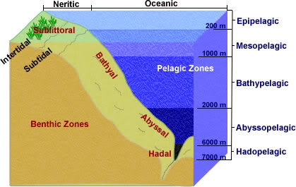
Vertical Pelagic Zones

Slide 17
Temperature
Where do we get our warmth?
The surface of the ocean gets the most sunlight, and in general, the most warmth.
As we go deeper, the water temperature decreases
As we learned in our presentations yesterday, what temperature is the most dense for water?
What does this mean?

Slide 18
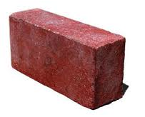
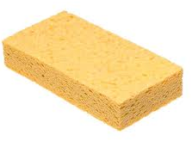
Temperature + Density
We learned that DENSITY is mass/volume. But why is this important?
Brick: 300 g/60 cm3 Sponge: 10 g/60 cm3
Density = 50 g/cm3 Density = .6 g/cm3

Slide 19
Temperature + water density
So if water is most dense at 4 C, where will it end up?

Slide 20
Oxygen
Where is there plenty of oxygen?
So where do you think there is plenty of oxygen?

Slide 21
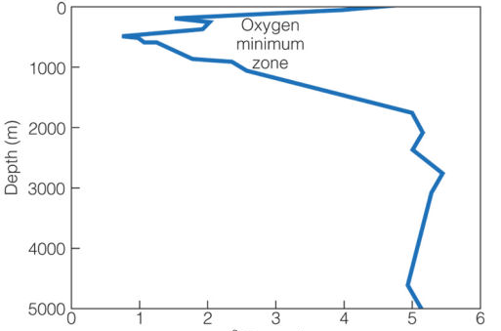
Oxygen in the ocean
SURFACE
Amount of Oxygen

Slide 22
Pressure
At the great depths, imagine the density of water pushing down on you!
As you go deeper, the PRESSURE increases
This is VERY interesting for how organisms evolved to live in the depths

Slide 23
Think-pair-share
So, let’s think about pressure. What kind of adaptations would you have to survive in the deep?
Think about this: can water compress water? What does pressure do to lungs?

Slide 24
Ocean zones project
Today we will be working on getting a better sense of these ocean zones.
You will need:
One large poster paper
Markers

Slide 25
Guidelines
One SIDE AXIS of your paper must be labeled DEPTH and have increments of this depth from:
0 m to 11,000 m
Label all zones

