Slide 1
Plastics in the water column
Where can you find plastic in the water column and how might it affect the animals that live there?

Slide 2
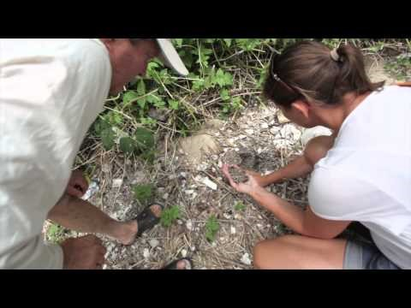
Investigating plastic pollution

Slide 3
Group the plastic objects
Group the items in your plastic bag as you see fit
Be ready to discuss your reasoning for choosing these groups

Slide 4
Sink or float?
Predict which items you think will float, which will sink, which are neutrally buoyant.
Record the name of each item on your chart and your predictions
What is a fair test for this experiment? How can we minimize variables?
Once I’ve checked you off, you may start testing

