Slide 1
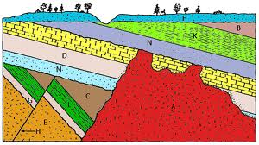
Relative Age Dating
What is it?
It’s a technique used to determine the sequence of geologic events from cross-sections of strata (rocks) in a given area.
Notes:
It was one of the earliest ways for geologists to help determine the order of past geological events.
Still important today in dating strata that lack radioactive isotopes (used in absolute age dating techniques).

Slide 2
5 Important Age Dating Principles
Principle of superposition: in a sequence of undeformed sedimentary rocks, the oldest beds are on the bottom and the youngest are on the top.
Principle of original horizontality: sedimentary layers are horizontal, or nearly so, when originally deposited. Strata that are not horizontal have been deformed by movements of the Earths crust.

Slide 3
Age Dating Principles Cont.
Principle of faunal succession: groups of fossil plants and animals occur in the geologic record in a definite and determinable order. A period of geologic time can be recognized by its respective fossils.
Principle of crosscutting relations: geologic features, such as faults, and igneous intrusions are younger than the rocks they cut.
Principle of inclusion: a rock body that contains inclusions of preexisting rocks is younger that the rocks from which the inclusions came from

Slide 4
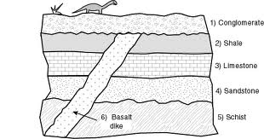
Let’s work on this together

Slide 5
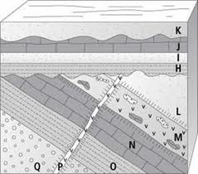
And this one?
Notes:
Youngest: K, J, I, H, P, L, M, N, O, Q :Oldest
A thrust fault is a type of fault, or break in the Earth's crust across which there has been relative movement, in which rocks of lower stratigraphic position are pushed up and over higher strata.
They are often recognized because they place older rocks above younger. Thrust faults are the result of compressional forces.

