Slide 1
Water Project
What is your gallons per capita per day?

Slide 2
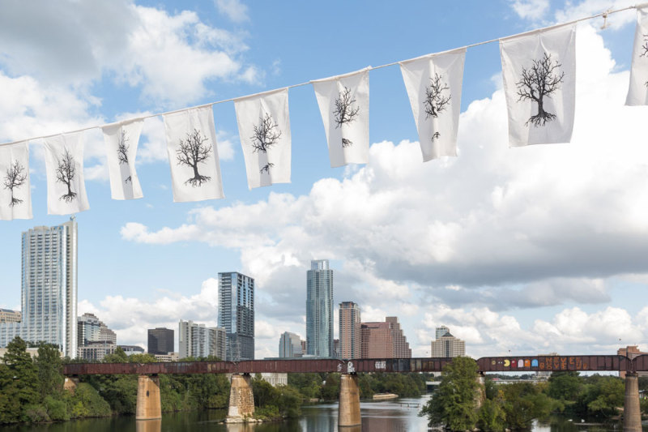
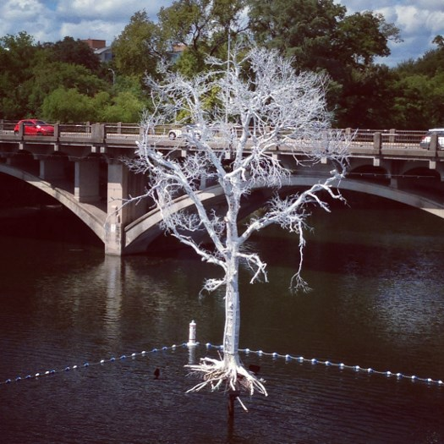
Photo Credits: Google Images
Notes:
Thirst project acknowledges 300 million trees that suffered from recent Texas droughts

Slide 3
The Global Problem
Almost 1 Billion on our planet don’t have access to safe, clean drinking water and proper sanitization. That’s one in every eight of us.
4,400 children die every day from diseases caused by contaminated water. That’s approximately one child every 15 seconds.
80% of all global diseases are water-borne and result from drinking contaminated water. These diseases kill more than 2.2 million people every year.
The average distance a woman walks to collect water is 3.75 miles.

Slide 4
The Global Solution
WATER!
Consider your water use habits, how can you use less?
Water is a human right, without it there is no life
What can you do to help other communities that don’t have access to clean drinking water?

Slide 5
The Local Project
Track your water use for 7 consecutive days
Analyze your water use
Describe your water use and some ways that you might be able to conserve water in the future
Consider the idea of being in a developing country where you would have to travel 3.75 miles one way to get water for each day

